Slide 1
Machine Learning (ML)
ML is an application of AI that provides Systems or Models the ability to automatically learn and improve from experience without being explicitly programmed and without human intervention .
Machine Learning (ML) is a subfield of artificial intelligence (AI) that focuses on the development of algorithms and models that enable computers to learn and make predictions or decisions without being explicitly programmed for a specific task.
The primary aim of machine learning is to allow the computers learn automatically without human intervention or assistance and adjust actions accordingly.
Examples:
The Self-Driving Car
The Spam Filter
Music Recommender
Personal Assistance (Alexa)

Slide 2
Definition:
According to Tom Mitchell Machine Learning is the study of algorithms that improve their performance P at some task T with experience E. A well-defined learning task for a system is given by <P, T, E>.
AI, ML and DL:
AI: Creation of Intelligent Machines that think and act like a Humans Ex: Robots.
ML: Approach for Computers to learn without being explicitly programmed.
DL: Training of Machines to think like a human brains- Application of Artificial Neural Networks.

Slide 3
Traditional Programming V/S Machine Learning :
Traditional Programming:
In traditional programming, a computer engineer writes a series of directions that instruct a computer how to transform input data into a desired output. Instructions are mostly based on an IF-THEN structure: when certain conditions are met, the program executes a specific action.
Machine Learning:
Machine learning, on the other hand, is an automated process that enables machines to solve problems with little or no human input, and take actions based on past observations.

Slide 4
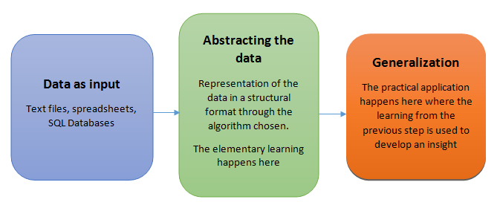
Basic machine learning process:
The basic machine learning process can be divided into three parts.
Data Input: Past data or information is utilized as a basis for future decision-making
Abstraction (Creating a Internal representation of the data by capturing the essential information): The input data is represented in a broader way through the underlying algorithm
Generalization: Generalization refers to the ability of a model to perform well on new, unseen data that it hasn't been trained on.

Slide 5
Data Input:
This is the foundation of any machine learning task. Data can come from various sources like sensors, databases, logs, text files, and images.
The data should be relevant to the problem you're trying to solve, diverse enough to capture different scenarios, and accurate to avoid misleading the model.
Often, data needs pre-processing before feeding it into the model. This can involve cleaning, formatting, feature engineering (creating new features), and handling missing values.
Note:
The quality and quantity of the input data significantly impact the effectiveness of the machine learning model.

Slide 6
Abstraction: (Training the model):
During the machine learning process, knowledge is fed in the form of input data.
This is where the magic happens! The chosen machine learning algorithm analyzes the processed data, searching for patterns, relationships, and underlying structures.
The algorithm creates an internal representation of the data, capturing the essential information it needs for prediction. This abstraction can be mathematical equations, rules, decision trees, or even complex neural networks.
Think of it like summarizing a book into key themes and plot points; the abstraction captures the essence or core of the information without needing all the details.
The choice of the model used to solve a specific learning problem is a human task. The decision related to the choice of model is taken based on multiple aspects, some of which are listed below:
The type of problem to be solved: Whether the problem is related to prediction or forecast , analysis of trend, understanding the different segments or groups of objects, etc.
Nature of the input data: How exhaustive the input data is, whether the data has no values for many fields, the data types etc.
Domain of the problem: If the problem is in a business critical domain with a high rate of data input and need for immediate inference, e.g. fraud detection problem in banking domain.

Slide 7
Generalization:
Generalization refers to the ability of a model to perform well on new, unseen data that it hasn't been trained on. The ultimate goal of a machine learning model is not just to memorize the training data but to learn underlying patterns and relationships that can be applied to new, unseen data in a meaningful way.
The first part of machine learning process is abstraction i.e. abstract the knowledge which comes as input data in the form of a model. However, this abstraction process, or more popularly training the model, is just one part of machine learning. The other key part is to tune up the abstracted knowledge to a form which can be used to take future decisions. This is achieved as a part of generalization.
This is where the model's power lies. Based on the abstracted representation, the model goes beyond the specific data it was trained on and learns to make general predictions for unseen data.
This part is quite difficult to achieve. This is because the model is trained based on a finite set of data, which may possess a limited set of characteristics. But when we want to apply the model to take decision on a set of unknown data, usually termed as test data.

Slide 8
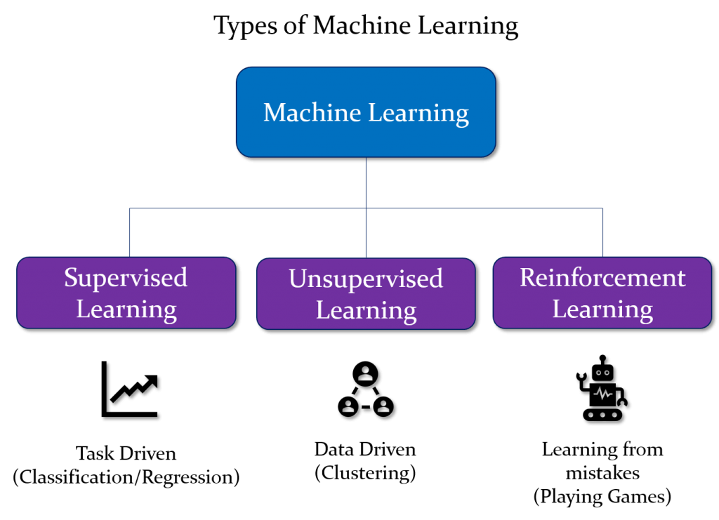

Slide 9
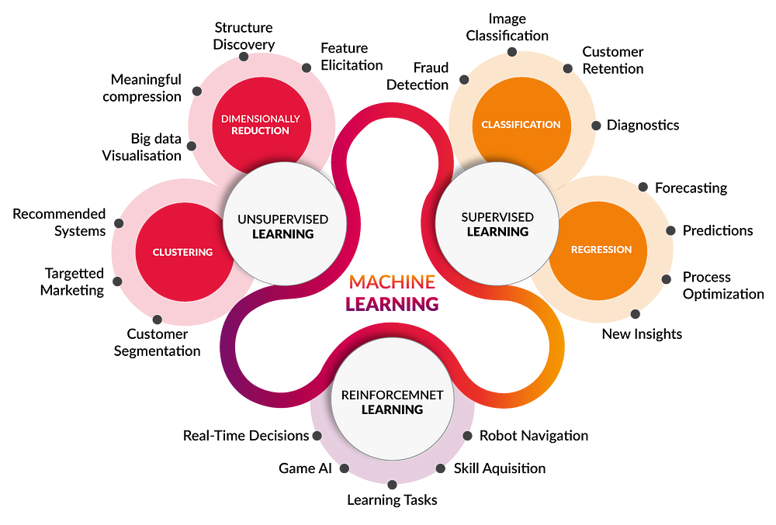

Slide 10
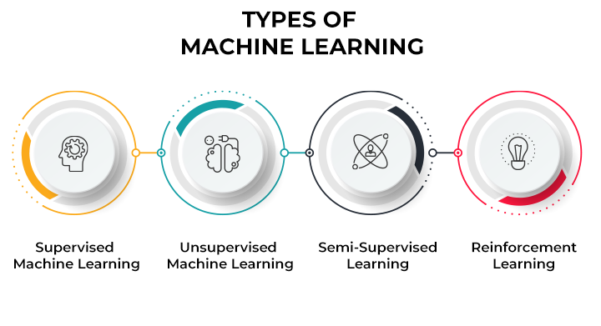

Slide 11
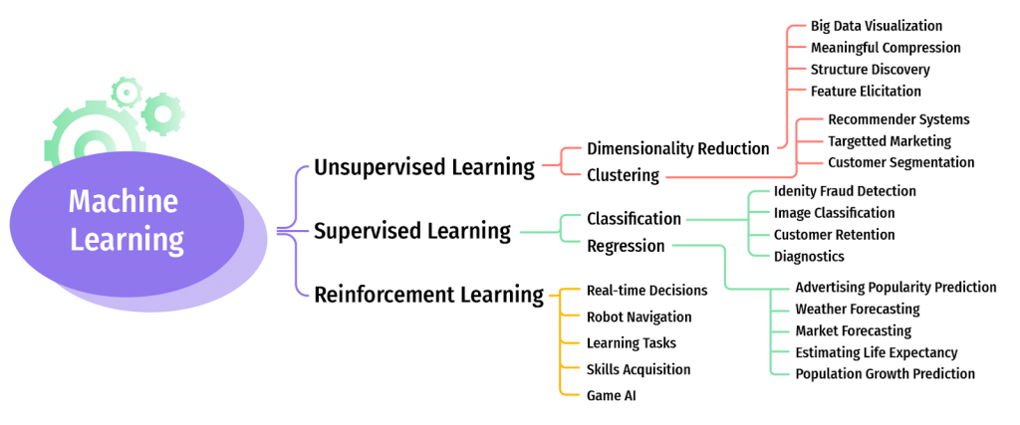
ML and It’s Application

Slide 12
Supervised learning:
Supervised learning is the types of machine learning in which machines are trained using well "labelled" training data, and on basis of that data, machines predict the output. The labelled data means some input data is already tagged or labelled with the correct output.
In supervised learning, the training data provided to the machines work as the supervisor that teaches the machines to predict the output correctly. It applies the same concept as a student learns in the supervision of the teacher. Supervised learning is a process of providing input data as well as correct output data to the machine learning model. The aim of a supervised learning algorithm is to find a mapping function to map the input variable(x) with the output variable(y).
So, the goal of supervised learning is to learn a mapping from inputs to outputs, so that the model can make accurate predictions on new, unseen data.
Note:
In supervised learning, models are trained using labelled dataset, where the model learns about each type of data. Once the training process is completed, the model is tested on the basis of test data (a subset of the training set), and then it predicts the output.
https://www.youtube.com/watch?v=olFxW7kdtP8

Slide 13
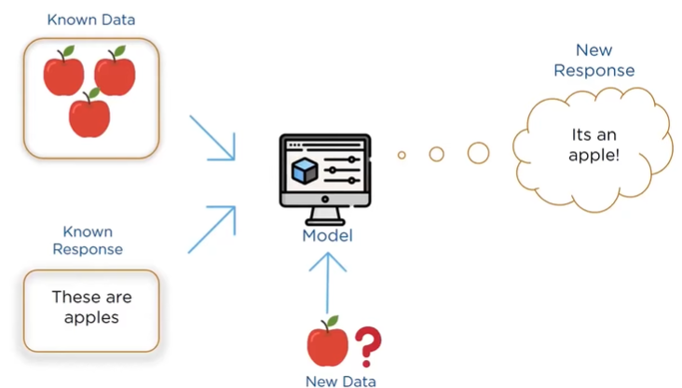

Slide 14
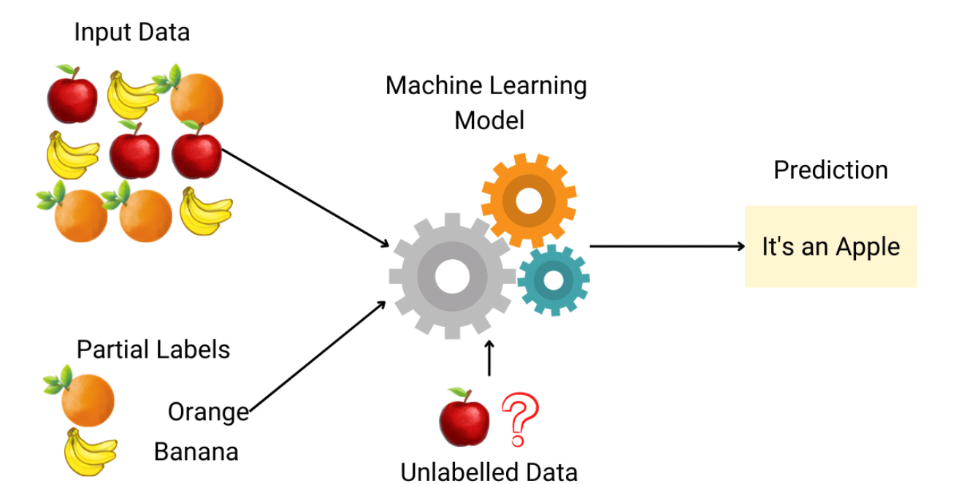

Slide 15
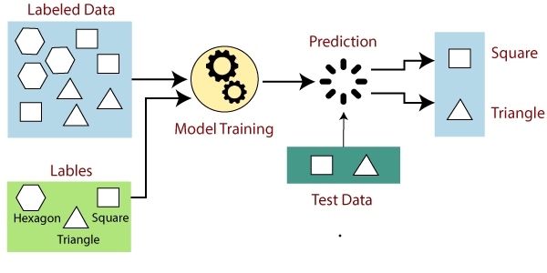

Slide 16
Explanation:
Suppose we have a dataset of different types of shapes which includes square, rectangle, triangle, and Polygon. Now the first step is that we need to train the model for each shape.
If the given shape has four sides, and all the sides are equal, then it will be labelled as a Square.
If the given shape has three sides, then it will be labelled as a triangle.
If the given shape has six equal sides then it will be labelled as hexagon.
Now, after training, we test our model using the test set, and the task of the model is to identify the shape. The machine is already trained on all types of shapes, and when it finds a new shape, it classifies the shape on the bases of a number of sides, and predicts the output

Slide 17
Example-3: Predicting Housing Prices
Let's consider a common example of supervised learning: predicting housing prices based on various features.
Input Features:
Size of the house (in square feet)
Number of bedrooms
Number of bathrooms
Distance to the city center
Presence of nearby amenities (e.g., schools, parks)
Labels (Outputs):
Sale price of the house
Training Dataset:
A dataset containing historical examples of houses with features and their corresponding sale prices.
Model:
A supervised learning algorithm, such as linear regression, is chosen to learn the relationship between the input features and the sale prices.

Slide 18
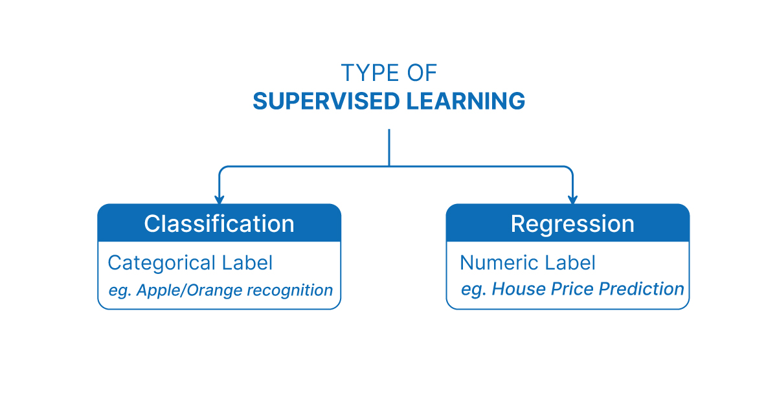

Slide 19
Classification:
Classification is a type of supervised machine learning task where the goal is to predict the category or class that a new instance or observation belongs to, on the basis of training data. The output variable in classification is discrete and represents different classes or labels.
In Classification, a program learns from the given dataset or observations and then classifies new observation into a number of classes or groups. Such as, Yes or No, 0 or 1, Spam or Not Spam, cat or dog, etc. Classes can be called as targets/labels or categories.
Unlike regression, the output variable of Classification is a category, not a value, such as "Green or Blue", "fruit or animal", etc. Since the Classification algorithm is a Supervised learning technique, hence it takes labeled input data, which means it contains input with the corresponding output. The best example of an ML classification algorithm is Email Spam Detector.
The main goal of the Classification algorithm is to identify the category of a given dataset, and these algorithms are mainly used to predict the output for the categorical data.

Slide 20
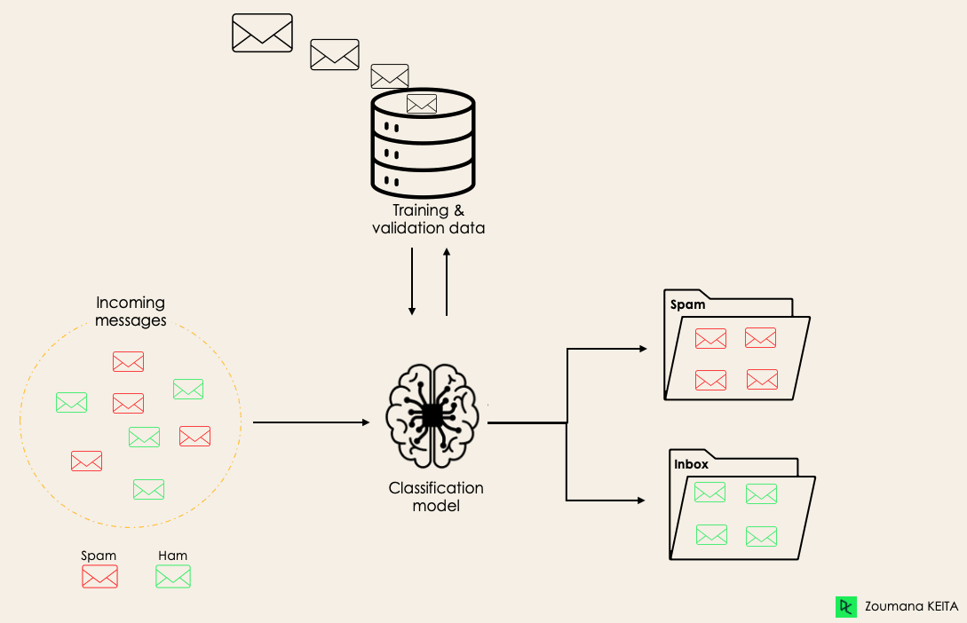
Spam Detection

Slide 21
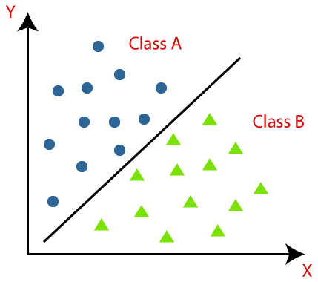
Example-2:
Classification algorithms can be better understood using the below diagram. In the below diagram, there are two classes, class A and Class B. These classes have features that are similar to each other and dissimilar to other classes.
The algorithm which implements the classification on a dataset is known as a classifier.
There are two types of Classifications:
Binary Classification
Multi-class Classifier

Slide 22
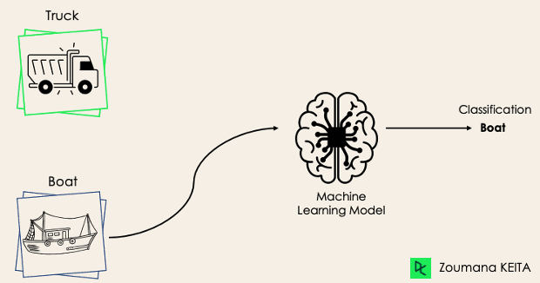
Binary Classification
In a binary classification task, the goal is to classify the input data into two mutually exclusive categories. The training data in such a situation is labeled in a binary format: true and false; positive and negative; O and 1; spam and not spam, male or female etc. depending on the problem being tackled.
For instance, we might want to detect whether a given image is a truck or a boat.
In Binary classification task, “Mutually Exclusive" means that the two categories or classes into which the input data is classified are distinct and cannot occur simultaneously for a single instance of input data.
An email cannot be both "spam" and "not spam" at the same time.
Note: If the classification problem has only two possible outcomes, then it is called as Binary Classifier.

Slide 23
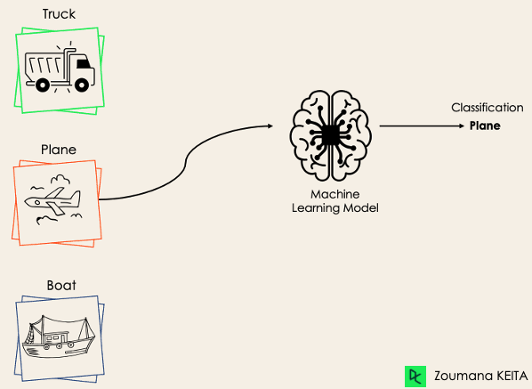
If a classification problem has more than two outcomes, then it is called as Multi-class Classifier.
Example: Classifications of types of crops, Classification of types of music.
Multi-Class Classification:
The multi-class classification, on the other hand, has at least two mutually exclusive class labels, where the goal is to predict to which class a given input example belongs to. In the following case, the model correctly classified the image to be a plane.

Slide 24
Regression :
Regression is a type of supervised machine learning task where the goal is to predict a continuous numerical value or outcome based on input features.
Regression is a type of supervised machine learning where algorithms learn from the data to predict continuous values such as sales, salary, weight, or temperature.
Note: In the context of regression in machine learning, a continuous numerical value refers to an outcome or target variable that can take on an infinite number of values within a specific range. In case of predicting a person's age, age is considered a continuous numerical value because it can theoretically take on any value within a certain range (for example, from 0 to 100+ years). There are no gaps or intervals between possible ages, and age can be expressed as a decimal or fraction if necessary (e.g., 25.5 years).
It is a variable that can have any real number value, and there are no distinct categories or classes. The term "continuous" implies that the variable can vary over a continuous range, and there are no gaps or interruptions in the possible values it can take. In contrast, in a classification task, the target variable would be a discrete set of categories or classes.
Note:
Here, “discrete set of categories or classes" refers to a set of distinct and separate values that a variable can take

Slide 25
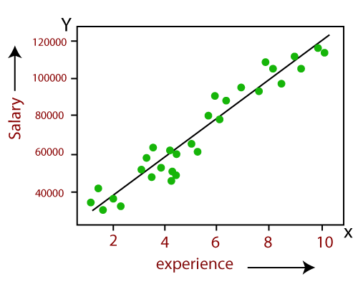
Example:
Linear Regression:
Predicting the salary of an employee on the basis of the year of experience.

Slide 26
Example:
Predicting age of a person: Given certain features or attributes of a person, such as height, weight, gender, and other relevant factors, the task is to predict the person's age in years.
Predicting the price of houses based on their features:
In real estate markets, house prices can vary continuously based on factors such as location, size, amenities, market conditions, and other features. The House prices can range from a few thousand dollars for smaller properties in certain areas to millions of dollars for luxury properties in prime locations.

Slide 27
Important to Note:
Let us consider two examples, say ‘predicting whether a tumour is malignant or benign’ and ‘price prediction in the domain of real estate? Are these two problems same in nature? The answer is ‘no’ It is true that both of them are problems related to prediction. However, for tumour prediction, we are trying to predict which category or class, i.e. ‘malignant’ or ‘benign’, an unknown input data related to tumour belongs to. In the other case, that is, for price prediction, we are trying to predict an absolute value and not a class. When we are trying to predict a categorical or nominal variable, the problem is known as a classification problem. A classification problem is one where the output variable is a category such as ‘red’ or ‘blue’ or ‘malignant tumour’ or ‘benign tumour’ etc. Whereas when we are trying to predict a numerical variable such as ‘price’, ‘weight’, etc. the problem falls under the category of regression.

Slide 28
Regression analysis :
Regression analysis is a statistical method to model the relationship between a dependent (target) and independent (predictor) variables with one or more independent variables. More specifically, Regression analysis helps us to understand how the value of the dependent variable is changing corresponding to an independent variable when other independent variables are held fixed. It predicts continuous/real values such as temperature, age, salary, price etc. Regression is a supervised learning which helps in finding the correlation between variables and enables us to predict the continuous output variable based on the one or more predictor variables.
It is mainly used for prediction, forecasting, time series modeling, and determining the causal-effect relationship between variables.

Slide 29
Unsupervised Learning:
Unsupervised Machine learning is a type of machine learning where the algorithm is trained on unlabeled data, and the objective is to find patterns, relationships, or structures within the data without explicit guidance or labeled outcomes. i.e Unsupervised learning is a method we use to group data when no labels are present.
As the name suggests, unsupervised learning is a machine learning technique in which models are not supervised using training dataset. Instead, models itself find the hidden patterns and insights from the given data. It can be compared to learning which takes place in the human brain while learning new things.
It can be defined as: “Unsupervised learning is a type of machine learning in which models are trained using unlabeled dataset and are allowed to act on that data without any supervision.”
Unsupervised learning cannot be directly applied to a regression or classification problem because unlike supervised learning, we have the input data but no corresponding output data.
Example:
Suppose the unsupervised learning algorithm is given an input dataset containing images of different types of cats and dogs. The algorithm is never trained upon the given dataset, which means it does not have any idea about the features of the dataset. The task of the unsupervised learning algorithm is to identify the image features on their own. Unsupervised learning algorithm will perform this task by clustering the image dataset into the groups according to similarities between images.

Slide 30
Why use Unsupervised Learning?
Unsupervised learning is helpful for finding useful insights from the data.
Unsupervised learning is much similar as a human learns to think by their own experiences, which makes it closer to the real AI.
Unsupervised learning works on unlabeled and uncategorized data which make unsupervised learning more important.
In real-world, we do not always have input data with the corresponding output so to solve such cases, we need unsupervised learning.
Semi-supervised Learning: Unsupervised ML techniques can also be combined with supervised ML in semi-supervised learning approaches. In this paradigm, a small amount of labeled data is augmented with a larger amount of unlabeled data to improve the performance of supervised models.
Note:
Unsupervised machine learning (ML) works differently from supervised ML because it doesn't rely on labeled data to learn patterns or make predictions. Instead, unsupervised ML algorithms focus on finding hidden structure or patterns within the data without explicit guidance from predefined labels.

Slide 31
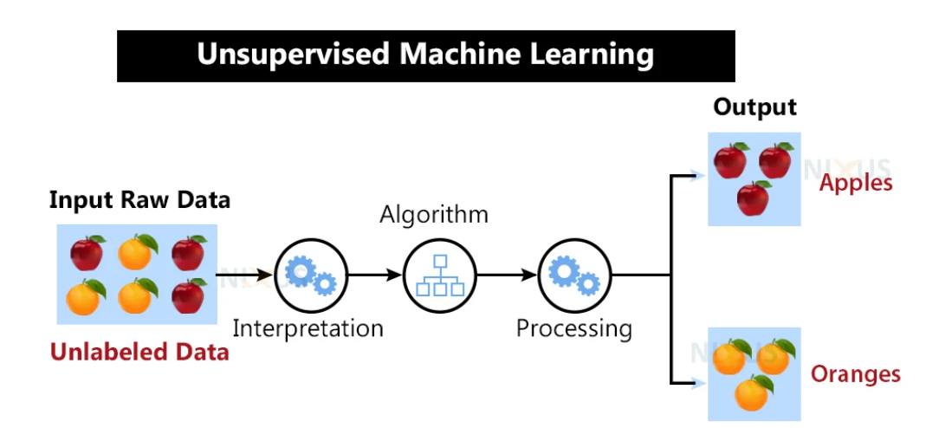

Slide 32
Here, we have taken an unlabeled input data, which means it is not categorized and corresponding outputs are also not given. Now, this unlabeled input data is fed to the machine learning model in order to train it. Firstly, it will interpret the raw data to find the hidden patterns from the data and then will apply suitable algorithms such as k-means clustering, Decision tree, etc. Once it applies the suitable algorithm, the algorithm divides the data objects into groups according to the similarities and dissimilarities between the objects.
Working of Unsupervised learning models:
We feed the model data with no categories or outputs for training
Model interprets raw data to identify hidden patterns
Depending on data, we use suitable algorithms
Algorithm groups data

Slide 33
Disadvantages of Unsupervised Learning:
1. Unsupervised learning is fundamentally more difficult than supervised learning since it lacks comparable results.
2. The outcome of an unsupervised learning approach may be less accurate since the input data does not have labels and algorithms do not know the precise output in advance.
3. We need humans to validate the results of unsupervised learning models which convolutes the process.
4. The operations involved require a high level of computational power and also take up a lot of time.
Alternative to Unsupervised Learning:
Semi-supervised learning may be a viable alternative to unsupervised learning. It is a combination or even a min-and-match of both unsupervised and supervised learning methods. The primary benefit of this sort of training would be that it lowers errors.
For example, it will only cluster the unlabeled data that fits the clustering criteria, and it will categorize the output automatically once it has labels. This uses less computer power and takes less time.

Slide 34
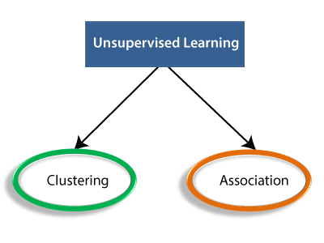
Types of Unsupervised Learning:
1. Clustering
2. Association rules
3. Dimensionality reduction.

Slide 35
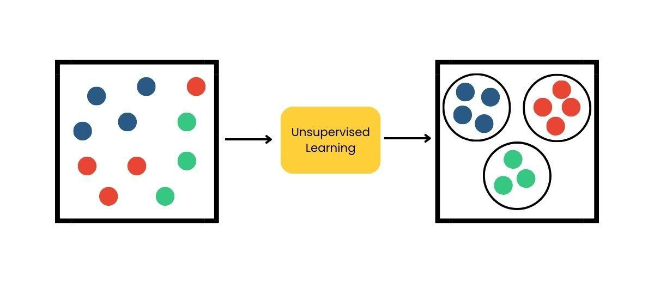
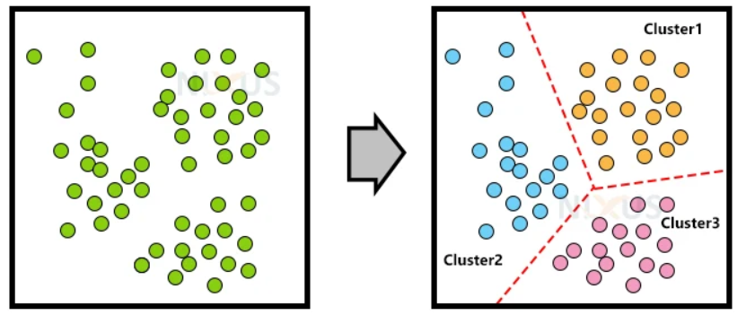
Clustering:
Clustering methods involve grouping untagged data based on their similarities and differences. When two instances appear in different groups, we can infer they have dissimilar properties.
Clustering is a type of unsupervised learning, meaning that we do not need labeled data for clustering algorithms; this is one of the biggest advantages of clustering over other supervised learning like Classification.
Clustering is the process of arranging a group of objects in such a manner that the objects in the same group (which is referred to as a cluster) are more similar to each other than to the objects in any other group.
OR

Slide 36
Application of Clustering:
1. Customer Segmentation:
Objective: Grouping customers based on similarities in purchasing behavior, demographics, or preferences.
Application: Targeted marketing, personalized recommendations, and tailored customer experiences.
2. Document Clustering:
Objective: Grouping similar documents based on content, topic, or language.
Application: Document categorization, information retrieval, and organizing large document repositories.
3. Anomaly Detection:
Objective: Identifying unusual patterns or outliers in a dataset.
Application: Fraud detection in financial transactions, network intrusion detection, and fault detection in industrial systems.
4. Retail Market Basket Analysis:
Objective: Identifying associations and patterns in the purchasing behavior of customers.
Application: Recommender systems, optimizing product placements, and understanding customer buying habits.
5. E-commerce Product Bundling:
Objective: Grouping products that are often purchased together.
Application: Creating product bundles, improving cross-selling strategies, and enhancing the user shopping experience.

Slide 37
Association Rule:
An association rule is an unsupervised learning method which is used for finding the relationships between variables in the large database. It determines the set of items that occurs together in the dataset. Association rule makes marketing strategy more effective. Such as people who buy X item (suppose a bread) are also tend to purchase Y (Butter/Jam) item. A typical example of Association rule is Market Basket Analysis(MBA).
We typically see association rule mining used for market basket analysis: this is a data mining technique retailers use to gain a better understanding of customer purchasing patterns based on the relationships between various products.
So Association is the process of discovering interesting relationships, associations, or patterns within a dataset. This type of analysis is often applied to transactional data, where the goal is to identify associations between items or events that frequently co-occur. Association rules are used to express these relationships, and they help reveal hidden connections in the data.

Slide 38
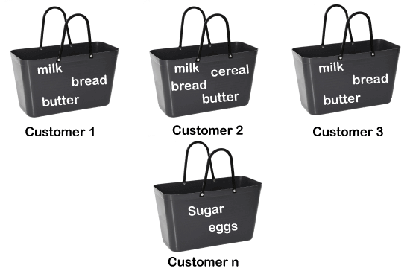
For example, if a customer buys bread, he most likely can also buy butter, eggs, or milk, so these products are stored within a shelf or mostly nearby.

Slide 39
3. Dimensionality Reduction:
Dimensionality reduction is a technique used in unsupervised machine learning to reduce the number of input features or variables in a dataset while preserving as much of its essential information.
In other words, it is a process of transforming high-dimensional data into a lower-dimensional space that still preserves the essence of the original data.
The primary goal is to overcome the curse of dimensionality, improve computational efficiency, and sometimes enhance the interpretability of the data.
Two common methods for dimensionality reduction are
Principal Component Analysis (PCA) and
t-Distributed Stochastic Neighbor Embedding (t-SNE).

Slide 40
Curse of dimensionality:
In machine learning, high-dimensional data refers to data with a large number of features or variables. The curse of dimensionality is a common problem in machine learning, where the performance of the model deteriorates or drops as the number of features increases.
This is because the complexity of the model increases with the number of features, and it becomes more difficult to find a good solution. In addition, high-dimensional data can also lead to overfitting, where the model fits the training data too closely and does not generalize well to new data.
It’s helpful to reduce the dimensionality of a dataset during EDA (Exploratory Data Analysis) to help visualize data: this is because visualizing data in more than three dimensions is difficult. From a data processing perspective, reducing the dimensionality of the data simplifies the modeling problem.
When more input features are being fed into the model, the model must learn a more complex approximation function. This phenomenon can be summed up by a saying called the “curse of dimensionality.”
Dimensionality reduction can help to mitigate these problems by reducing the complexity of the model and improving its generalization performance. There are two main approaches to dimensionality reduction: feature selection and feature extraction.

Slide 41
Feature Engineering:
Feature Selection:
Feature selection involves selecting a subset of the original features that are most relevant to the problem at hand. The goal is to reduce the dimensionality of the dataset while retaining the most important features.
There are several methods for feature selection, including
Filter methods
Wrapper methods
Embedded methods
Filter methods rank the features based on their relevance to the target variable, wrapper methods use the model performance as the criteria for selecting features, and embedded methods combine feature selection with the model training process.

Slide 42
2. Feature Extraction:
Feature extraction involves creating new features by combining or transforming the original features. The goal is to create a set of features that captures the essence of the original data in a lower-dimensional space. There are several methods for feature extraction, including:
principal component analysis (PCA)
linear discriminant analysis (LDA)
t-distributed stochastic neighbor embedding (t-SNE).
PCA is a popular technique that projects the original features onto a lower-dimensional space while preserving as much of the variance as possible.

Slide 43
Reinforcement Learning:
Reinforcement Learning (RL) is a type of machine learning paradigm in which an agent learns to make decisions by interacting with an environment. The agent takes actions in the environment, and in return, it receives feedback in the form of rewards or punishments.
Reinforcement Learning is a feedback-based Machine learning technique in which an agent learns to behave in an environment by performing the actions and seeing the results of actions. For each good action, the agent gets positive feedback, and for each bad action, the agent gets negative feedback or penalty. In Reinforcement Learning, the agent learns automatically using feedbacks without any labeled data, unlike supervised learning Since there is no labeled data, so the agent is bound to learn by its experience only. RL solves a specific type of problem where decision making is sequential, and the goal is long-term, such as game-playing, robotics, etc. The agent interacts with the environment and explores it by itself. The primary goal of an agent in reinforcement learning is to improve the performance by getting the maximum positive rewards.
The agent learns with the process of hit and trial, and based on the experience, it learns to perform the task in a better way. Hence, we can say that "Reinforcement learning is a type of machine learning method where an intelligent agent (computer program) interacts with the environment and learns to act within that." How a Robotic dog learns the movement of his arms is an example of Reinforcement learning.
It is a core part of Artificial Intelligence, and all AI agent works on the concept of reinforcement learning. Here we do not need to pre-program the agent, as it learns from its own experience without any human intervention

Slide 44
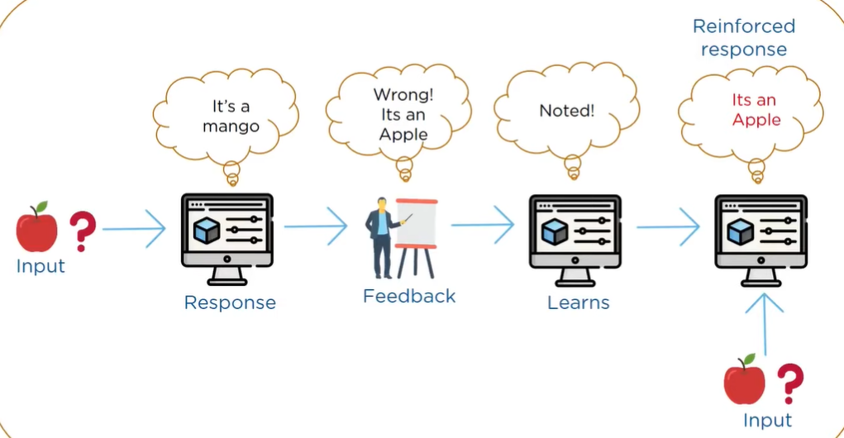
Example

Slide 45
MACHINE LEARNING ACTIVITIES:
The first step in machine learning activity starts with data. In case of supervised learning, it is the labelled training data set followed by test data which is not labelled. In case of unsupervised learning, there is no question of labelled data but the task is to find patterns in the input data.
A thorough review and exploration of the data is needed to understand the type of the data, the quality of the data and relationship between the different data elements. Based on that, multiple pre-processing activities may need to be done on the input data before we can go ahead with core machine learning activities. Following are the typical preparation activities done once the input data comes into the machine learning system:
Understand the type of data in the given input data set (For example Numerical Data).
Explore the data to understand the nature and quality.
Explore the relationships amongst the data elements, e.g. inter-feature relationship.
Find potential issues in data. (you might find missing values, outliers, duplicate entries, or data entry errors)
Do the necessary remediation, e.g. impute missing data values, etc., if needed. Once issues are identified, you take steps to address them.
Apply the following pre-processing steps, as necessary.
1. Dimensionality Reduction
2. Feature sub-set selection
Once the data is prepared for modelling, then the learning tasks start off.

Slide 46
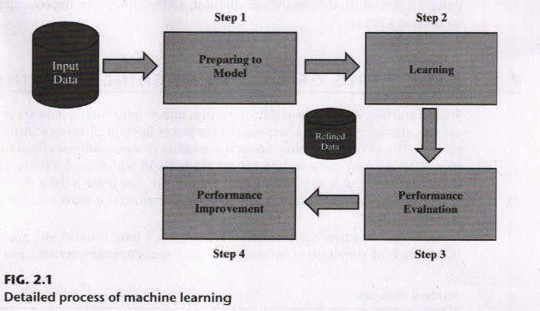
Once the data is prepared for modelling, then the learning tasks start off. As a part of it, do the following activities:
“ The input data is first divided into parts — the training data and the test data (called holdout). This step is applicable for supervised learning only.
Consider different models or learning algorithms for selection. “Train the model based on the training data for supervised learning problem and apply to unknown data. Directly apply the chosen unsupervised model on the input data for unsupervised learning problem.
After the model is selected, trained (for supervised learning), and applied on input data, the performance of the model is evaluated. Based on options available, specific actions can be taken to improve the performance of the model, if possible.

Slide 47
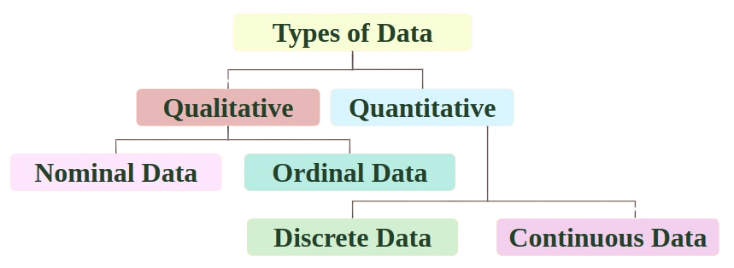
Interval
Ratio
Note:
Data can be classified into different types based on its nature and characteristics. Two primary classifications of data are qualitative (categorical) and quantitative (numerical).

Slide 48
Qualitative Data: (Non- Measurable One)
Definition: Qualitative data, also known as categorical data, represents characteristics or attributes that are not measured on a numerical scale. Instead, they are categorical in nature and represent different categories or groups.
For example, if we consider the quality of performance of students in terms of ‘Good’ ‘Average’, and ‘Poor’ it falls under the category of qualitative data.
Examples:
Gender (Male, Female)
Color (Red, Blue, Green)
Marital Status (Married, Single, Divorced)
Type of Vehicle (Car, Truck, Motorcycle)
Characteristics:
Non-numeric in nature.
Represents categories or groups.
Can be nominal (unordered) or ordinal (ordered)

Slide 49
Qualitative data can be further subdivided into two types as follows: (Also Called a Categorical Level of Measurement):
Nominal data (Unordered data)
Ordinal data (Ordered)
1. Nominal data :
Nominal data represents categories or groups with no inherent order or ranking. Nominal data does not follow any hierarchy. The categories are distinct and, mutually exclusive (separate) but there is no meaningful numerical value associated with them.
Examples of nominal data are :
Blood group: A, B, O, AB, etc.
Nationality: Indian, American, British, etc.
Gender: Male, Female, Other.
EXAMPLE-1: Let us understand nominal data with an example. For instance, the color of a car can be black, red, or orange. Here we need to realize that no color is greater than the other. It just represents a particular color of a car.
EXAMPLE-2: Mutually exclusive (separate) means - consider a categorical variable representing different types of fruits: Apple, Banana, and Orange. If a fruit is categorized as an "Apple," it cannot simultaneously be categorized as a "Banana" or "Orange." Each fruit type is distinct, and there is no overlap or sharing of categories among observations.

Slide 50
Note:
A special case of nominal data is when only two labels are possible, e.g. pass/fail as a result of an examination. This sub-type of nominal data is called ‘dichotomous’ It is obvious, mathematical operations such as addition, subtraction, multiplication, etc. cannot be performed on nominal data. For that reason, statistical functions such as mean, variance, etc. can also not be applied on nominal data. However, a basic count is possible. So, mode, i.e. most frequently occurring value, can be identified for nominal data.
That is, Statistical functions that rely on numerical calculations, such as mean and variance, cannot be applied directly to nominal data. However, basic operations like counting the frequency of each category and identifying the mode (most frequently occurring value) are still possible and meaningful.

Slide 51
2. Ordinal:
Ordinal data represents categories or groups with a specific order or ranking. While the categories themselves are distinct and mutually exclusive, they also have a meaningful sequence or hierarchy.
In addition to possessing the properties of nominal data, can also be naturally ordered. This means ordinal data also assigns named values to attributes but unlike nominal data, they can be arranged in a sequence of increasing or decreasing value so that we can say whether a value is better than or greater than another value.
Examples of ordinal data are:
Customer satisfaction: ‘Very Happy’ ‘Happy’ ‘Unhappy; etc.
Grades: A, B, C, etc.
Hardness of Metal: ‘Very Hard’, ‘Hard’, ‘Soft’, etc.
Likert scale responses :Strongly Disagree, Disagree, Neutral, Agree, Strongly Agree
Educational levels :High School, Bachelor's, Master's, Ph.D.
Performance ratings :Poor, Fair, Good, Excellent
Like nominal data, basic counting is possible for ordinal data. Hence, the mode can be identified. Since ordering is possible in case of ordinal data, median, and quartiles can be identified in addition.
Note:
Categories are distinct and mutually exclusive: means that each category represents a unique and separate level of the variable, and no observation can belong to more than one category simultaneously.

Slide 52
2. Quantitative Data: (Measurable One)
Definition: Quantitative data, also known as numerical data, consists of numerical measurements or quantities that can be expressed as numbers and subjected to mathematical operations. It involves values that can be expressed as numbers and subjected to mathematical operations.
For example, if we consider the attribute ‘marks’ it can be measured using a scale of measurement. Quantitative data is also termed as numeric data.
Examples:
Height (in centimeters or inches)
Age (in years)
Income (in dollars)
Temperature (in Celsius or Fahrenheit)
Number of products sold.
Test scores.
Characteristics:
Numeric in nature.
Can be discrete or continuous.
Allows for mathematical operations such as addition, subtraction, multiplication, and division.

Slide 53
There are Four types of quantitative data:
Discrete
Continues
Interval data
Ratio data
Discrete Data: (Whole Number or a Number without Fractional Part)
Data that can only take certain values is called discrete data or discrete values. This is data that can be counted and has a limited number of values. It usually comes in the form of whole numbers or integers.
Examples:
Number of siblings.
Number of goals scored in a soccer match.
Number of defects in a manufacturing process.
Number of customers in a store at a given time.
Age of a Person
Number of cars in a parking lot

Slide 54
2. Continues Data: (Number with Fractional Part)
Continuous data is data that can take any value. Height, weight, temperature and length are all examples of continuous data. Some continuous data will change over time; the weight of a baby in its first year or the temperature in a room throughout the day.
Continuous data represents measurements that can take on any value within a certain range. These values are not restricted to whole numbers and can include decimals or fractions.
Example:
Height of individuals.
Weight of objects.
Temperature readings.
Time taken to complete a task.
Distance traveled by a vehicle.

Slide 55
3. Interval data : (Numerical Level of Measurements) Interval data is a type of quantitative or Numerical data that represents numerical values where the difference between any two adjacent points is meaningful and consistent, but there is no true zero point. In other words, interval data has equal intervals between consecutive points on the scale, but the absence of a zero point does not imply the absence of the attribute being measured.
Specifically Interval level of data has Order like ordinal data, but in addition to this the spaces between the measurement points are equal, unlike ordinal data.
Examples:
Credit Scores which ranges from 300 – 850
2. Temperature:
Temperature measured in degrees Celsius (°C) or Fahrenheit (°F) is an example of interval data. The difference between any two adjacent points on the temperature scale represents a consistent amount of change, but there is no true zero point. For example, the difference between 20°C and 30°C is the same as the difference between 30°C and 40°C which is 10°C, but a temperature of 0°C does not signify the absence of temperature i.e The temperature of 0°C does not mean that there is no temperature. So the zero is arbitrary. Therefore, the absence of a zero point does not imply the absence of the attribute being measured.

Slide 56
4. Ratio: is more sophisticated level of measurement.
Ratio data is a type of quantitative data that shares characteristics with interval data but includes a true zero point, allowing for meaningful ratios and comparisons.
Ratio data represents numeric data for which exact value can be measured. Absolute zero is available for ratio data. Also, these variables can be added, subtracted, multiplied, or divided. The central tendency can be measured by mean, median, or mode and methods of dispersion such as standard deviation. Examples of ratio data include height, weight, age, salary etc.
So what makes the ratio the king of measurement level is that the zero point reflects an absolute meaningful zero, unlike interval level data.
For Example:
1. Height and weight measurements: Height and weight are examples of ratio data. A height of 0 centimeters or a weight of 0 kilograms represents the absence of height or weight, making ratios and comparisons meaningful.
2. Age: Age, when measured in years, is ratio data because it includes a true zero point (birth). A person who is 30 years old is twice as old as a person who is 15 years old.
3. Income: Income levels, when measured in currency (e.g., dollars), are ratio data. A person with an income of $0 has no income, and ratios can be calculated to compare incomes between individuals.

Slide 57
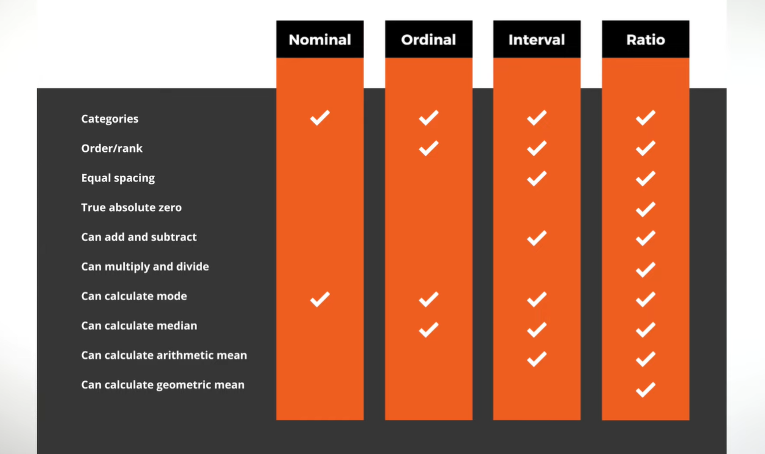
Why Diff Levels of Measurement

Slide 58
Why Diff Levels of Measurement
Because It is very important to define types of data , is because the level of measurement for any set of data will directly impact which statistical test we can and cannot use on it.
For example we can only calculate the mean, the average, for certain levels of data as shown in the diagram. So, if you try to run a statistical test on a unsuitable data set , data that is at the wrong level of measurement we will end up with meaningless result.
So we need to understand what we are dealing with before we really work with the numbers.
The Level of Measurement impacts which statistical test you can use.

Slide 59
What is Feature:
A feature is an attribute of a data set that is used in a machine learning process.
In machine learning, features are individual independent variables that act like a input in our system. Actually, while making the predictions, models use such features to make the predictions. And using the feature engineering process, new features can also be obtained from old features in machine learning.
The features in a data set are also called its dimensions. Hence, a data set having ‘n’ features is called an n-dimensional data set.
Examples of features:
In a document, the word count, character count and the number of pages could be the features. Hence, it can be called as 3 dimensional dimageata set.
In a black and white, the length, width, number of black pixels and number of white pixels could be its features. Hence, it is known as 4-dimensional data set

Slide 60
FEATURE ENGINEERING:
Feature engineering refers to the process of translating a data set into features such that these features are able to represent the data set more effectively and result in a better learning performance. Feature engineering is an important pre-processing step for machine learning. It has two major elements:
Feature transformation
Feature subset selection
Feature engineering is the process of creating new features or modifying existing ones from the raw data to improve the performance of machine learning models. It involves selecting, transforming, and creating features that are relevant and informative for the task at hand. Effective feature engineering can lead to better model performance and generalization.

Slide 61
Feature transformation:
Feature transformation transforms the data — structured or unstructured, into a new set of features which can represent the underlying problem which machine learning is trying to solve.
Feature transformation involves changing the representation of the features in the dataset to make them more suitable for the machine learning algorithm.
Engineering a good feature space is a crucial prerequisite for the success of any machine learning model. However, often it is not clear which feature is more important. For that reason, all available attributes of the data set are used as features and the problem of identifying the important features is left to the learning model. This is definitely not a feasible approach, particularly for certain domains e.g. medical image classification, text categorization, etc. In case a model has to be trained to classify a document as spam or non-spam, we can represent a document as a bag of words. Then the feature space will contain all unique words occurring across all documents. This will easily be a feature space of a few hundred thousand features. If we start including bigrams or trigrams along with words, the count of features will run in millions. To deal with this problem, feature transformation comes into play. Feature transformation is used as an effective tool for dimensionality reduction and hence for boosting learning model performance. Broadly, there are two distinct goals of feature transformation:
Achieving best reconstruction of the original features in the data set
Achieving highest efficiency in the learning task
There are two variants of feature transformation:
1. Feature construction (or Generation):
2. Feature extraction:

Slide 62
Feature construction (or Generation):
Feature construction involves creating new features by combining or transforming the existing features in the dataset. This process discovers missing information about the relationships between features and increases the feature space by creating additional features. Hence, if there are ‘n’ features or dimensions in a data set, after feature construction ‘m’ more features or dimensions may get added. So at the end, the data set will become ‘n + m’ dimensional.
Feature construction involves transforming a given set of input features to generate a new set of more powerful features. To understand more clearly, let’s take the example of a real estate data set having details of all apartments sold in a specific region. The data set has three features — apartment length, apartment breadth, and price of the apartment. If it is used as an input to a regression problem, such data can be training data for the regression model. So given the training data, the model should be able to predict the price of an apartment whose price is not known or which has just come up for sale. However, instead of using length and breadth of the apartment as a predictor, it is much convenient and makes more sense to use the area of the apartment, which is not an existing feature of the data set. Hence, such a feature, namely apartment area, can be added to the data set. In other words, we transform the three-dimensional data set to a four-dimensional data set, with the newly ‘discovered’ feature apartment area being added to the original data set.
2. Feature extraction:
Feature extraction involves reducing the dimensionality of the data by selecting or extracting a subset of relevant features from the original feature set. This process aims to retain as much relevant information as possible while discarding redundant or irrelevant features.
Unlike feature construction, which creates entirely new features, feature extraction aims to capture the essence of the original features in a more compact or meaningful representation.

Slide 63
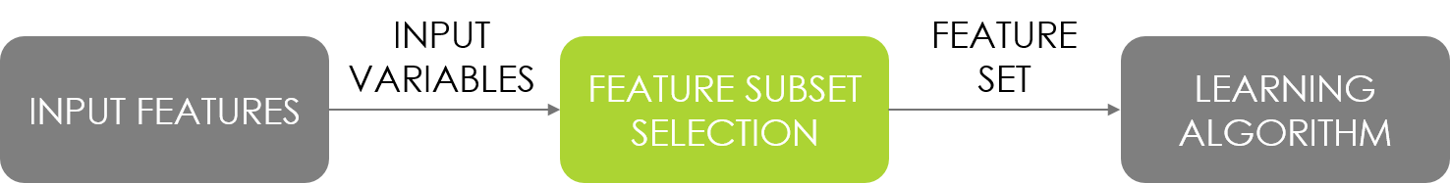
Feature subset selection: (or simply feature selection)
In Feature subset selection no new feature is generated. Feature subset selection is a technique in feature engineering that involves choosing a subset of most relevant features from the original set of features in a dataset. The goal is to improve the model's performance by reducing the dimensionality of the data and eliminating irrelevant or redundant features. This process can lead to more efficient and interpretable models, as well as potentially faster training times.
Certainly! Feature selection is a critical process in machine learning aimed at identifying the most relevant subset of features from the original set of features in a dataset. Initially, we have a set of features F={F1​,F2​,...,Fn​}, representing various attributes of the data. The goal is to derive a subset F′={Fj​,Fo​,...,Fm​} from F, where m<n and Fj​,Fo​,...,Fm​ are the selected features. Among these selected features, Fy​ represents the subset deemed most meaningful and relevant for the machine learning task at hand.

Slide 64
Feature Extraction Algorithms:
The most popular Feature extraction algorithms in Machine Learning are:
Principal Component Analysis
Singular value decomposition
Linear Discriminant Analysis

Slide 65
Introduction to Bayesian Learning:
Bayes theorem is given by an English statistician, philosopher, and Presbyterian minister named Mr. Thomas Bayes in 17th century. Bayes theorem is also known with some other name such as Bayes rule or Bayes Law.
Bayes theorem helps to determine the probability of an event with random knowledge. It is used to calculate the probability of occurring one event while other one already occurred. It is a best method to relate the condition probability and marginal probability.
In simple words, we can say that Bayes theorem helps to contribute more accurate results.
Bayesian Learning: A Probabilistic Approach to Machine Learning
Bayesian learning is a powerful statistical approach that utilizes probability to create and update models based on data. Unlike traditional machine learning algorithms that focus on minimizing error, Bayesian learning works by estimating the posterior probability of a model being correct given the observed data.
In the context of Bayesian learning, "observed data" refers to the data that is available for analysis and model training. It consists of the input features and corresponding labels or outcomes that are used to build and update the model.

Slide 66
Key concepts:
Probabilistic Framework: Everything in Bayesian learning is expressed in terms of probabilities. This allows for uncertainty quantification and flexible model updates as new data arrives.
2. Prior Probability:
Before seeing any data, you express your initial belief about the model parameters using a prior distribution. This prior reflects your existing knowledge or assumptions about the problem.
3. Likelihood: (Something Which is likely to occur)
This represents the probability of observing the data given a specific set of model parameters. It tells you how well the model explains the data.
4. Posterior Probability:
Using Bayes' theorem, you combine the prior and likelihood to calculate the posterior probability, which reflects your updated belief about the model parameters after seeing the data.
5. Continuous Learning:
As new data becomes available, the posterior probability is recalculated, effectively updating the model and incorporating the new information.

Slide 67
Example for Bayesian Learning: Spam Filtering
Imagine you're training a filter to classify emails as spam or not spam.
Prior: You might start with a prior belief that 5% of emails are spam (prior probability).
Likelihood: If you have features like "words in subject line" and "sender domain," you can calculate the likelihood that an email is spam based on these features.
Posterior: Using Bayes' theorem, you update your belief about whether an email is spam based on the actual words in the email and the sender domain.
Continual Learning: As you receive more emails with classifications (spam or not spam), you can keep updating your posterior probabilities and priors for better filtering.

Slide 68
Features of Bayesian learning :
The features of Bayesian learning methods that have made them popular are as follows:
Prior knowledge of the candidate hypothesis is combined with the observed data for arriving at the final probability of a hypothesis. So, two important components are the prior probability of each candidate hypothesis and the probability distribution over the observed data set for each possible hypothesis.
The Bayesian approach to learning is more flexible than the other approaches because each observed training pattern can influence the outcome of the hypothesis by increasing or decreasing the estimated probability about the hypothesis, whereas most of the other algorithms tend to eliminate a hypothesis if that is inconsistent with the single training pattern.
Bayesian methods can perform better than the other methods while validating the hypotheses that make probabilistic predictions. For example, when starting a new software project, on the basis of the demographics of the project, we can predict the probability of encountering challenges during execution of the project.
Through the easy approach of Bayesian methods, it is possible to classify new instances by combining the predictions of multiple hypotheses, weighted by their respective probabilities.
In some cases, when Bayesian methods cannot compute the outcome deterministically, they can be used to create a standard for the optimal decision against which the performance of other methods can be measured.

Slide 69
Bayes Theorem: (Conditional Probability)
Bayes theorem is one of the most popular machine learning concepts that helps to calculate the probability of occurring one event with uncertain knowledge while other one has already occurred.
In ML, Bayes Theorem is used to calculate the probability of a Hypothesis (theory) or an event based on prior knowledge or evidence.
Bayes' Theorem is a fundamental concept in probability theory and statistics, and it plays a crucial role in various machine learning algorithms, particularly those based on Bayesian inference. In machine learning, Bayes' Theorem is used to calculate the posterior probability of a hypothesis given observed data.
Here "observed data" refers to the dataset or information that is available for analysis. It consists of the input features and corresponding outcomes or labels that are used to make inferences or predictions.
Definition:
Bayes theorem One of the most well-known theories in machine learning, the Bayes theorem helps determine the likelihood that one event will occur with unclear information while another has already happened.
The mathematical formulation of the Bayes theorem is:

Slide 70
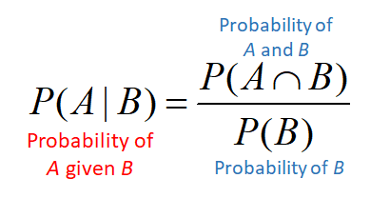

Conditional Probability: (Pre requisite for Bayes Theorem)
Conditional probability is a measure of the probability of an event occurring given that another event has already occurred. It is denoted as P(A∣B) and is read as "the probability of event A given event B.“
Formula for Conditional Probability for Event A given that (|) event B already occurred:
Here:
P(A∣B) is the conditional probability of event A given event B. So A and B are 2 events.
P(A∩B) is the joint probability of events A and B occurring together.
P(B) is the probability of event B.
Formula for Conditional Probability for Event B given that (|) event A already occurred:

Slide 71
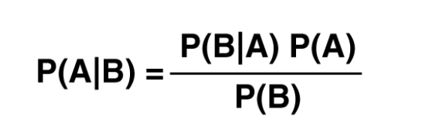
Derivation of Bayes Theorem:
Here: Conside A is our Hypothesis and B is the Evidence or data.
In P(A|B) : In this A is a Hypothesis and B is a evidence or data. So we have to find the probability of Hypothesis A given the Evidence or Data B.
To Compute the Posterior Probability P(A|B) we can’t find directly instead have to take the help of 3 other probability which is P(B|A), P(A) and P(B). So after combining Prior, Likelyhood, and Marginal probability we will get Posterior.
In P(B|A): Here the probability of Evidence B given that our Hypothesis A is True. So here Our Hypothesis is True and based on this we have to find the Probability of the Evidence.
P(A) : is Probability of our Hypothesis A before considering the Evidence or Data B.
P(B): Probability of the Evidence or given Data B
It states that the probability of an event A given that the event B has already occurred is equal to the probability of an event B given that the event A has occurred, Multiplied by the probability of event A, divided by probability of event B.

Slide 72
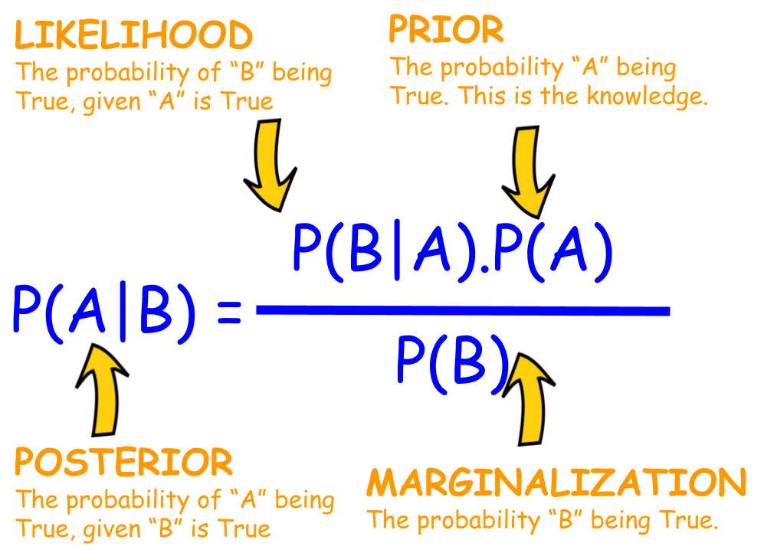

Slide 73
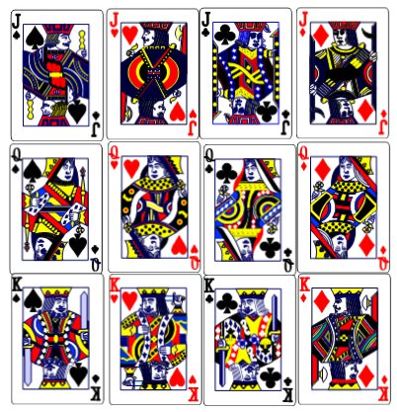
Example of Playing Card = 52. Now The card that I chose is a Face Card and the Problem is to find whether the face card is King or Not
Total Face Card: 12
Now we have to find the Following:
P(King | Face) = P(Face | King) P(King) / P(Face)
Here,
P(Face | King) : Means the card is King but the Probablity fo Face we have to find. Which is nothing but 1 as if we choose any king card it will be a face card.
P(King): Totally we have 4 King cards out of 52 so the probability of King is 4/52.
P(Face): Totally we have 12 Face cards out of 52 so the probability of Face is 12/52.
Finally,
P(King | Face) = (1 * 4/52 ) / (12/52)
= 1/3 1/3 of 12 Face is = 4
https://www.youtube.com/watch?v=Fv_LGQKgWi0

Slide 74
Prior Probability (Prior):
The prior probability represents our initial belief or knowledge about the likelihood of an event or hypothesis before we have observed any new evidence or data.
The prior probability serves as the starting point for Bayesian inference and influences the posterior probability.
The prior probability can be based on previous experience, domain knowledge, or assumptions.
Also called as Prior Probability is the prior knowledge or belief about the probabilities of various Hypothesis H is called Prior.
It is based on our prior knowledge, assumptions, or belief about the probability of the event.
For Example:
Suppose we want to determine the probability of a patient having a particular disease let's call it Disease X) before any diagnostic tests are performed. Our prior belief about the prevalence or spread of Disease X in the population is 0.05, meaning that 5% of the population is estimated to have Disease X based on historical data. This prior probability is denoted as P(Disease X)=0.05.
Let's say we want to predict whether a customer will buy a product or not based on their age, gender and income, before we predict we should have some prior knowledge.
if we have to determine whether a particular type of tumour is malignant for a patient, the prior knowledge of such tumours becoming malignant can be used to validate our current hypothesis and is a prior probability or simply called Prior.

Slide 75
Posterior:
The probability that a particular hypothesis holds for a data set based on the Prior is called the posterior probability or simply Posterior.
In the above example, the probability of the hypothesis that the patient has a malignant tumour considering the Prior of correctness of the malignancy testis a posterior probability.
The posterior probability represents our updated belief or probability of an event or hypothesis being true after observing new evidence or data.
The posterior probability is calculated using Bayes' theorem, which combines the prior probability, the likelihood, and the evidence or data.
The posterior probability reflects our updated understanding of the event or hypothesis based on the observed evidence.
Example:
After the patient undergoes a diagnostic test for Disease X and the test results come back positive, we want to update our belief about the probability of the patient having the disease. Using Bayes' theorem, we calculate the posterior probability of the patient having Disease X given the positive test result. Let's say the likelihood of a positive test result given that the patient has Disease X is 0.95, and the likelihood of a positive test result given that the patient does not have Disease X (false positive rate) is 0.10. Using Bayes' theorem, we update our prior probability to calculate the posterior probability:
P(Disease X | Positive Test) = P(Positive Test | Disease X)×P(Disease X) ​/ P(Positive Test)

Slide 76
Likelihood:
The likelihood represents the probability of observing the evidence or data given that a particular hypothesis or event is true. It measures how well the Hypothesis explains the observed data. i.e, The likelihood quantifies how well the observed data supports the hypothesis or event A.
The likelihood plays a crucial role in Bayesian inference as it helps update the prior probability to the posterior probability.
For Example:
The likelihood represents the probability of observing the evidence (test results) given the hypothesis (presence or absence of Disease X). In our example, the likelihood of a positive test result given that the patient has Disease X is 0.95, and the likelihood of a positive test result given that the patient does not have Disease X (false positive rate) is 0.10.
In summary, the prior probability represents our initial belief about the likelihood of an event (presence of Disease X), the posterior probability represents our updated belief after observing new evidence (positive test result), and the likelihood represents the probability of observing the evidence given the hypothesis. These concepts are fundamental to Bayesian inference and help us make informed decisions in uncertain situations, such as medical diagnosis.

Slide 77
In summary, in Bayesian theorem:
The prior probability represents our initial belief about the event or hypothesis.
The posterior probability represents our updated belief after observing new evidence.
The likelihood represents the probability of observing the evidence given the hypothesis.
These concepts together form the basis of Bayesian inference, allowing us to update our beliefs based on observed data and make probabilistic predictions or inferences.

Slide 78
Naive Bayes classifier:
The Naive Bayes classifier is a simple yet powerful probabilistic classifier based on Bayes' theorem. So the base of Naive Bayes classifier is Bayes' theorem.
Consider the Following Example:
Let’s say we have a Data Set with Features {x1, x2, x3, …… , xn} and the output {y}. Now the Task is to Classify the given data which is y by making use of the Features. For Navie Bayes Classifier we have to follow the Bayes Theorem, So according to the Bayes Theorem Formula we have to simplify our Problem.
Here, P(x1, x2, x3, ……, xn) is common for all the classes or records in the data set. So we can ignore it
Where ∝ denotes proportionality.
https://www.youtube.com/watch?v=jS1CKhALUBQ

Slide 79
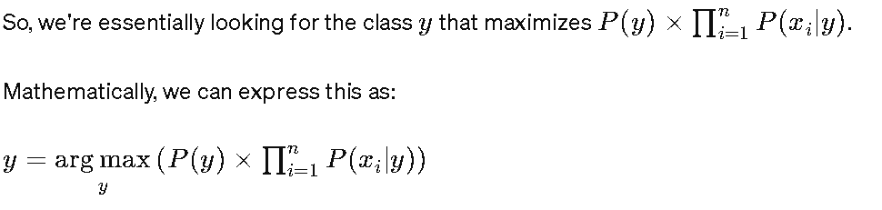
This equation implies that it is used to find the value of y that maximizes the expression In RHS. In other words, it returns the class label y that has the highest probability given the input features x1​,x2​,x3​,…,xn​.
For Example: Let say we have Binary Classifiier for Spam or Not Spam if we are getting the Probability = 0.7 for the Mail is Spam and 0.3 that the mail is Not Spam then we have to consider the maximum among these that is 0.7 which means the mail is Spam.

Slide 80
Steps in Naives Bayes Classifier:
The term "naive" in Naive Bayes classifier refers to the simplifying assumption made by the model regarding the independence of features. Specifically, it assumes that all features are conditionally independent given the class label. So all features of the dataset are equally important and independent, this is called Naive Bayes classifier
Naive Bayes classifier calculates the probability of an event in the following steps:
Step 1: Calculate the prior probability for given class labels
Step 2: Find Likelihood probability with each attribute for each class
Step 3: Put these value in Bayes Formula and calculate posterior probability.
Step 4: See which class has a higher probability, given the input belongs to the higher probability class.

Slide 81
Suppose we have a dataset with two classes, "spam" (denoted as y = spam) and "not spam" (denoted as y=not spam), and two features, x1​ and x2​.
We want to classify a new email with the following features:
x1​=buy
x2​=discount
Let's assume we have already calculated the following probabilities from our training dataset:
1. Prior probabilities:
P(spam)=0.4 // Consider it as 40% out of 100%
P(not spam)=0.6 // Consider it as 60%
2. Likelihoods:
P(buy∣spam)=0.8
P(discount∣spam)=0.6
P(buy∣not spam)=0.3
P(discount∣not spam)=0.5
Now, let's plug these values into the Naive Bayes classifier equation:

Slide 82
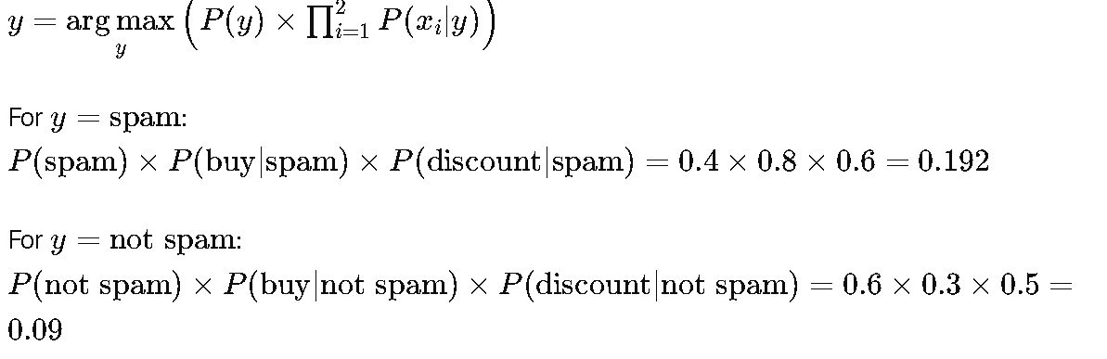
Comparing the two values, we see that y=spam gives the higher result.
Therefore, according to the Naive Bayes classifier, the predicted class for the given features "buy" and "discount" is "spam".

Slide 83
Example:
Suppose we have a dataset of emails labeled as either "spam" or "not spam" and each email is represented as a bag-of-words (i.e., a vector indicating the presence or absence of certain words). Here's a simplified version of the dataset:
Email | Label
"Get free money now" | spam
"Need a loan? Apply today" | spam
"Meeting for lunch today?" | not spam
"Get a discount on your next purchase" | spam
"Schedule for meeting tomorrow" | not spam
"Please review the attached document" | not spam

Slide 84
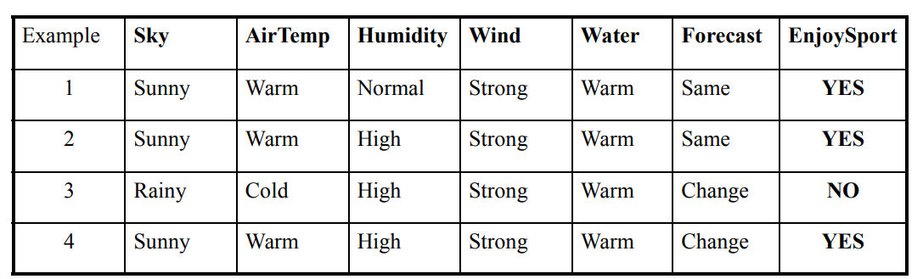
Example:
With relation to our example, this concept can be understood as:
We assume that no pair of features are dependent. For example, the Airtemp being ‘Hot’ has nothing to do with the humidity or the Sky being ‘Rainy’ has no effect on the winds. Hence, the features are assumed to be independent.
Secondly, each feature is given the same weight(or importance). For example, knowing only temperature and humidity alone can’t predict the outcome accurately. None of the attributes is irrelevant and assumed to be contributing equally to the outcome.

Slide 85
Naive Bayes classifier is a primary probabilistic classifier based on a view of applying Bayes’ theorem (from Bayesian inference with strong naive) independence assumptions. The prior probabilities in Bayes’ theorem that are changed with the help of newly available information are classified as posterior probabilities. A key benefit of the naive Bayes classifier is that it requires only a little bit of training information (data) to gauge the parameters (mean and differences of the variables) essential for the classification (arrangement). In the Naive Bayes classifier, independent variables are always assumed, and only the changes (variances) of the factors/variables for each class should be determined and not the whole covariance matrix. Because of the rather naive assumption that all features of the dataset are equally important and independent, this is called Naive Bayes classifier. Naive Bayes classifiers are direct linear classifiers that are known for being the straightforward, yet extremely proficient result. The modified version of Naive Bayes classifier originates from the assumption that information collection (data set) is commonly autonomous (mutually independent). In most of the practical scenarios, the ‘independence’ assumption is regularly violated.

Slide 86
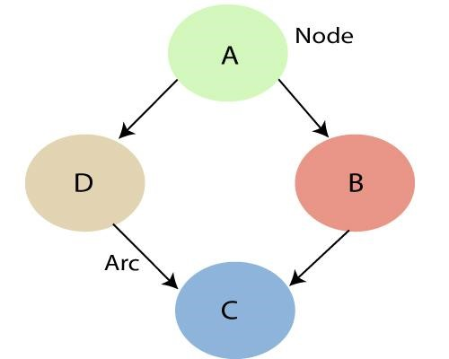
Bayesian Belief Network: (BBN)
Bayesian Belief Network or Bayesian Network or Belief Network is a Probabilistic Graphical Model (PGM) that represents a set of random variables and their conditional dependencies through a Directed Acyclic Graph (DAG).
It is a graphical representation of different probabilistic relationships among random variables in a particular set. Due to its feature of joint probability, the probability in Bayesian Belief Network is derived, based on a condition — P(attribute/parent) i.e probability of an attribute, true over parent attribute.
As mentioned above, by making use of the relationships which are specified by the Bayesian Network, we can obtain the Joint Probability Distribution (JPF) with the conditional probabilities. Each node in the graph represents a random variable and the arc (or directed arrow) represents the relationship between the nodes. They can be either continuous or discrete in nature.

Slide 87
Example of Bayesian Networks:
Let us now understand the mechanism of Bayesian Networks and their advantages with the help of a simple example. In this example, let us imagine that we are given the task of Modeling a student’s marks (m) for an exam he has just given. From the given Bayesian Network Graph below, we see that the marks depend upon two other variables. They are,
Exam Level (e)– This discrete variable denotes the difficulty of the exam and has two values (0 for easy and 1 for difficult)
IQ Level (i) – This represents the Intelligence Quotient level of the student and is also discrete in nature having two values (0 for low and 1 for high)
Additionally, the IQ level of the student also leads us to another variable, which is the Aptitude Score of the student (s). Now, with marks the student has scored, he can secure admission to a particular university. The probability distribution for getting admitted (a) to a university is also given below.

Slide 88
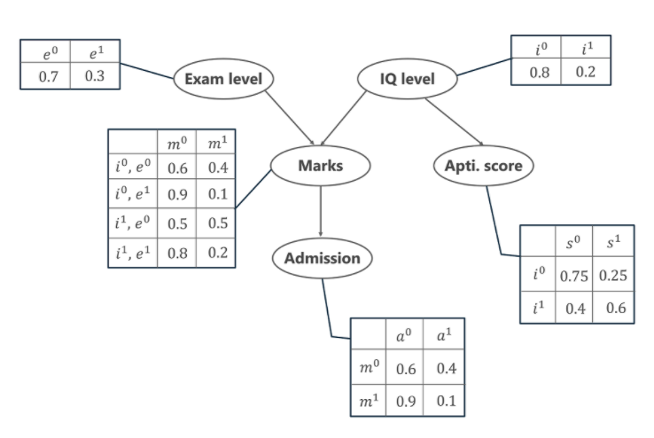
Student BBN
In the above graph, we see several tables representing the probability distribution values of the given 5 variables.

Slide 89
Supervised learning:
Supervised learning is the types of machine learning in which machines are trained using well "labelled" training data, and on basis of that data, machines predict the output. The labelled data means some input data is already tagged or labelled with the correct output.
In supervised learning, the training data provided to the machines work as the supervisor that teaches the machines to predict the output correctly. It applies the same concept as a student learns in the supervision of the teacher. Supervised learning is a process of providing input data as well as correct output data to the machine learning model. The aim of a supervised learning algorithm is to find a mapping function to map the input variable(x) with the output variable(y).
So, the goal of supervised learning is to learn a mapping from inputs to outputs, so that the model can make accurate predictions on new, unseen data.
Note:
In supervised learning, models are trained using labelled dataset, where the model learns about each type of data. Once the training process is completed, the model is tested on the basis of test data (a subset of the training set), and then it predicts the output.
https://www.youtube.com/watch?v=olFxW7kdtP8

Slide 91
Example-3: Predicting Housing Prices
Let's consider a common example of supervised learning: predicting housing prices based on various features.
Input Features:
Size of the house (in square feet)
Number of bedrooms
Number of bathrooms
Distance to the city center
Presence of nearby amenities (e.g., schools, parks)
Labels (Outputs):
Sale price of the house
Training Dataset:
A dataset containing historical examples of houses with features and their corresponding sale prices.
Model:
A supervised learning algorithm, such as linear regression, is chosen to learn the relationship between the input features and the sale prices.

Slide 93
Classification :
Classification is a type of supervised machine learning task where the goal is to predict the category or class that a new instance or observation belongs to, on the basis of training data. The output variable in classification is discrete and represents different classes or labels.
In Classification, a program learns from the given dataset or observations and then classifies new observation into a number of classes or groups. Such as, Yes or No, 0 or 1, Spam or Not Spam, cat or dog, etc. Classes can be called as targets/labels or categories.
Unlike regression, the output variable of Classification is a category, not a value, such as "Green or Blue", "fruit or animal", etc. Since the Classification algorithm is a Supervised learning technique, hence it takes labeled input data, which means it contains input with the corresponding output. The best example of an ML classification algorithm is Email Spam Detector.
The main goal of the Classification algorithm is to identify the category of a given dataset, and these algorithms are mainly used to predict the output for the categorical data.

Slide 94
Classification model:
Let us consider two examples, say ‘predicting whether a tumour is malignant or benign’ and ‘price prediction in the domain of real estate? Are these two problems same in nature? The answer is ‘no’ It is true that both of them are problems related to prediction. However, for tumour prediction, we are trying to predict which category or class, i.e. ‘malignant’ or ‘benign’, an unknown input data related to tumour belongs to. In the other case, that is, for price prediction, we are trying to predict an absolute value and not a class. When we are trying to predict a categorical or nominal variable, the problem is known as a classification problem. A classification problem is one where the output variable is a category such as ‘red’ or ‘blue’ or ‘malignant tumour’ or ‘benign tumour’ etc. Whereas when we are trying to predict a numerical variable such as ‘price’, ‘weight’, etc. the problem falls under the category of regression.

Slide 95
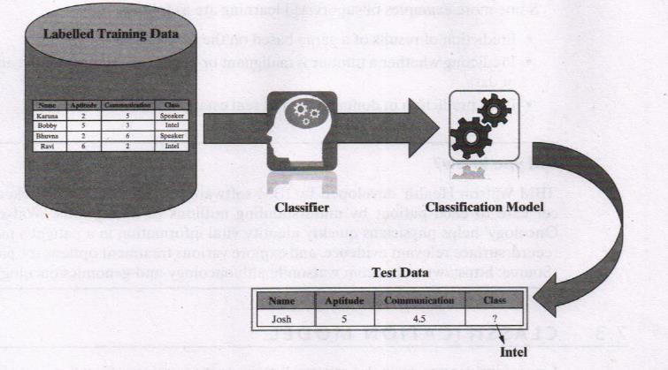
The figure depicts the typical process of classification where a classification model is obtained from the labelled training data by a classifier algorithm.

Slide 96
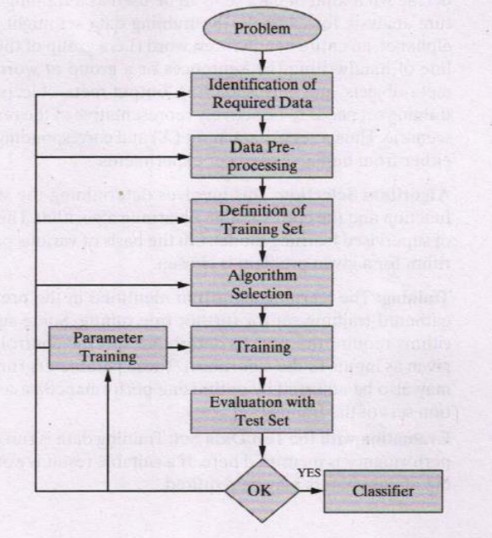
Classification Learning Steps:
Problem Identification:
Identifying the problem is the first step in the supervised learning model. The problem needs to be a well-formed problem, i.e. a problem with well-defined goals and benefit, which has a long-term impact.
Identification of Required Data:
On the basis of the problem identified above, the required data set that precisely represents the identified problem needs to be identified/evaluated.
For example: If the problem is to predict whether a tumour is malignant or benign, then the corresponding patient data sets related to malignant tumour and benign tumours are to be identified.

Slide 97
3. Data Pre-processing:
This is related to the cleaning/transforming the dataset. This step ensures that all the unnecessary/irrelevant data elements are removed. Data pre-processing refers to the transformations applied to the identified data before feeding the same into the algorithm. Because the data is gathered from different sources, it is usually collected in a raw format and is not ready for immediate analysis. This step ensures that the data is ready to be fed into the machine learning algorithm.
4. Definition of Training Data Set:
Before starting the analysis, the user should decide what kind of data set is to be used as a training set. In the case of signature analysis, for example, the training data set might be a single handwritten alphabet, an entire handwritten word(i.e. a group of the alphabets) or an entire line of handwriting (i.e. sentences or a group of words). Thus, a set of ‘input meta-objects’ and corresponding ‘output meta-objects’ are also gathered. The training set needs to be actively representative of the real-world use of the given scenario. Thus, a set of data input (X) and corresponding outputs (Y) is gathered either from human experts or experiments.
5. Algorithm Selection:
This involves determining the structure of the learning function and the corresponding learning algorithm. This is the most critical step of supervised learning model. On the basis of various parameters, the best algorithm for a given problem is chosen.

Slide 98
6. Training:
The learning algorithm identified in the previous step is run on the gathered training set for further fine tuning. Some supervised learning algorithms require the user to determine specific control parameters (which are given as inputs to the algorithm). These parameters (inputs given to algorithm) may also be adjusted by optimizing performance on a subset (called as validation set) of the training set.
7. Evaluation with the Test Data Set:
Training data is run on the algorithm, and its performance is measured here. If a suitable result is not obtained, further training of parameters may be required.

Slide 99
Classification Algorithms:
The most common classification algorithms used are
K-Nearest Neighbor (kNN)
Decision tree
Random forest
Support Vector Machine (SVM)

Slide 100
k-Nearest Neighbour (kNN)
The kNN algorithm is a simple but extremely powerful Classification and Regression algorithm. The name of the algorithm originates from the underlying philosophy of KNN —i.e. people having similar background or mindset tend to stay close to each other. In other words, neighbours in a locality have a similar background.
In the same way, as a part of the KNN algorithm, the unknown and unlabelled data which comes for a prediction problem is judged on the basis of the training data set elements which are similar to the unknown element. So, the class label of the unknown element is assigned on the basis of the class labels of the similar training data set elements.
The k-nearest neighbors (KNN) algorithm is often referred to as a “LAZY" learning algorithm because it does not involve a training phase where the model learns explicit patterns from the training data. Instead, during the training phase, KNN simply memorizes the entire training dataset. This means that the model does not attempt to generalize or build a compact representation of the data.
Hyper Parameter: K
Hyperparameters are parameters whose values are set before the learning process begins.

Slide 101
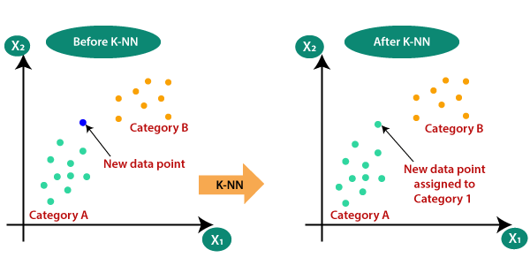
Working Of KNN Algorithm
Feature
K = 5
Feature
Note: The value of the K must me Odd number

Slide 102
Algorithm:
Step 1 − For implementing any algorithm, we need dataset. So in the first step of KNN, we
must load the training as well as test data.
Step 2 − Next, we need to choose the value of K (Initialize the K) i.e. the nearest data points. K can be any integer. K is a Hyper Parameter.
Step 3 − For each point in the test data do the following
3.1 − Calculate the distance between test data and each row of training data with the help of Euclidean distance.
3.2 − Now, based on the distance value, sort them in ascending order.
3.3 − Next, it will choose the top K rows from the sorted array. i.e First K entries from the array.
3.4 − Now, it will assign a class to the test point based on most frequent class of these
rows.
3.5 − If it is a Regression problem then return the Mean of the K labels.
3.6 − If it is a Classification Problem ten return the Mode of the K labels.
Step 4 − End

Slide 103
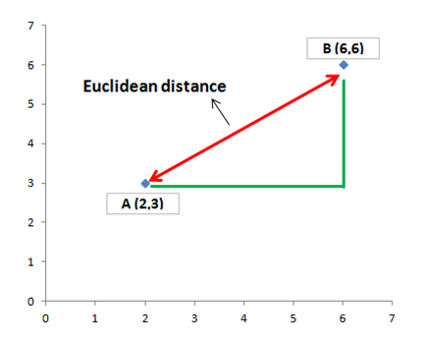
Euclidean Distance:
We mostly use this distance measurement technique to find the distance between consecutive points. It is generally used to find the distance between two real-valued vectors. Euclidean distance is used when we have to calculate the distance of real values like integer, float, etc… One issue with this distance measurement technique is that we have to normalize or standard the data into a balance scale otherwise the outcome will not preferable.
Let’s take an example of a 2-Dimensional vector and take a geometrical intuition of distance measures on 2-Dim data for a better understanding.
The Euclidean distance between two points A and B in n-dimensional space is calculated using the formula:
Where:
A=(a1​,a2​,…,an​) and B=(b1​,b2​,…,bn​) are the coordinates of the two points in n-dimensional space.
ai​ and bi​ are the ith coordinates of points A and B, respectively.

Slide 104
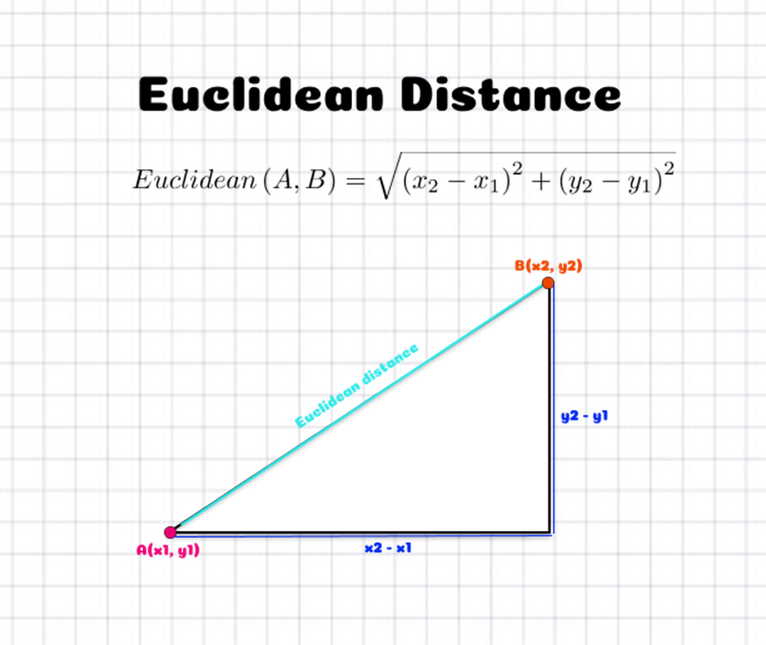

Slide 105
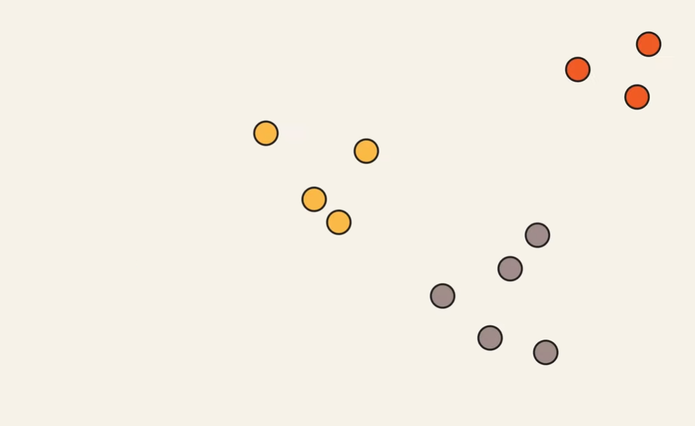
Example-2

Slide 106
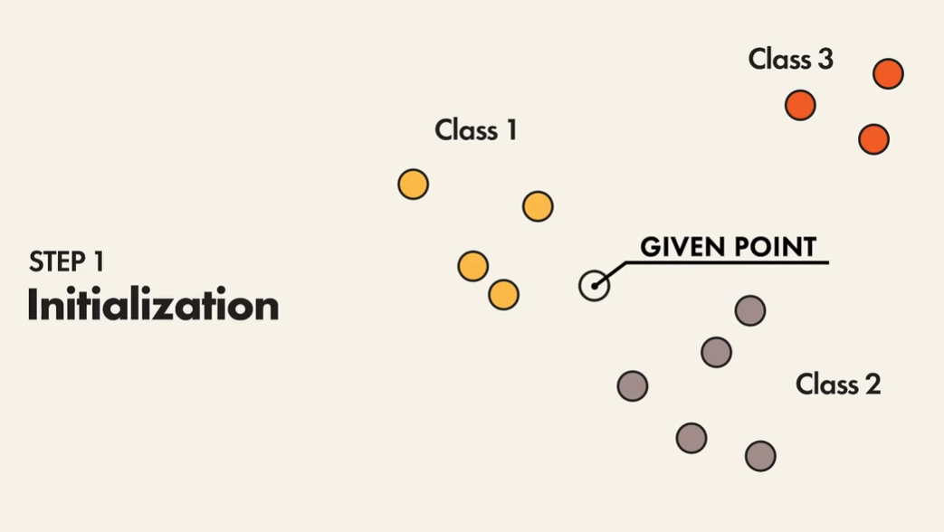

Slide 107
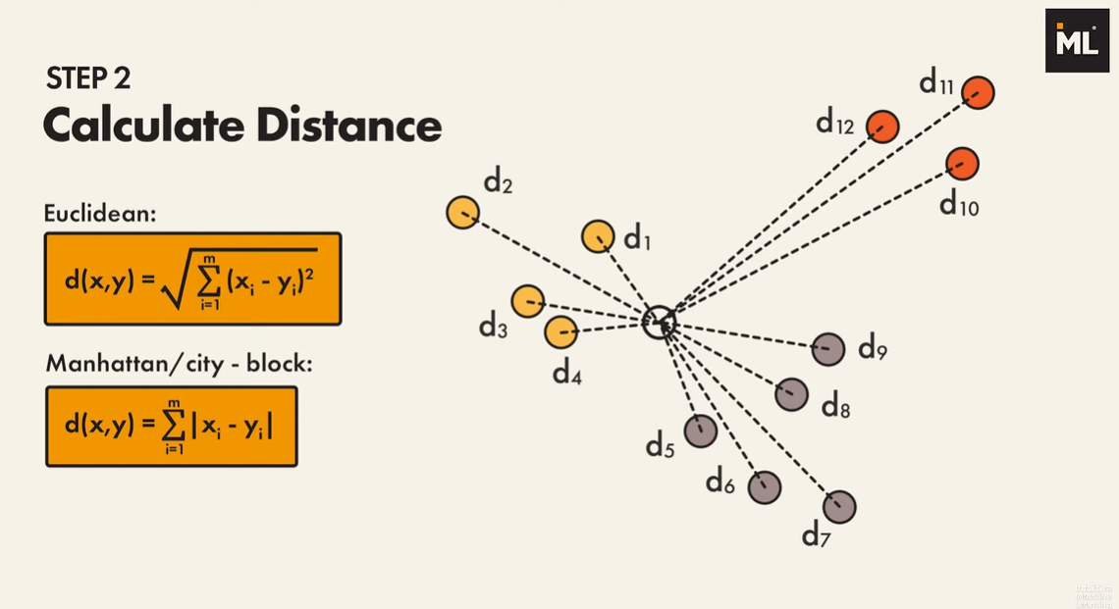

Slide 108
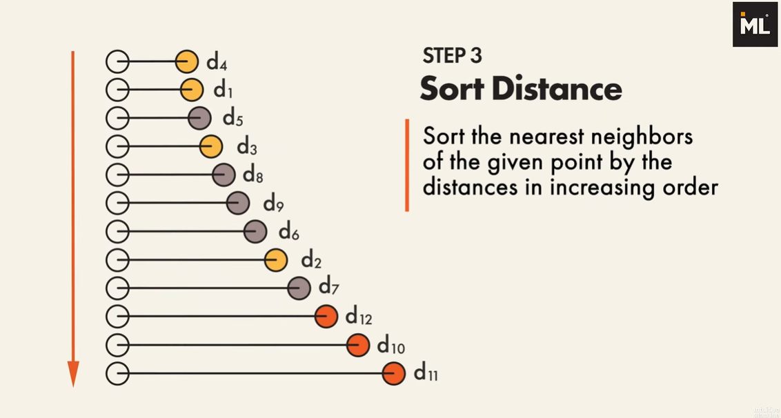

Slide 109
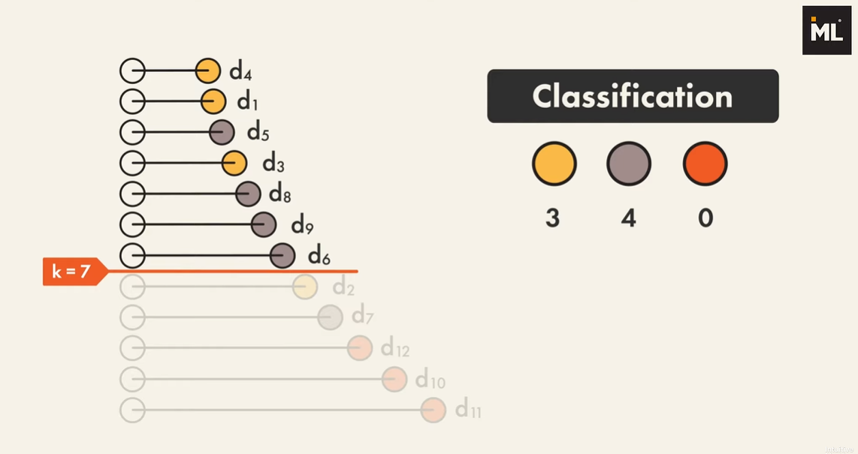

Slide 110
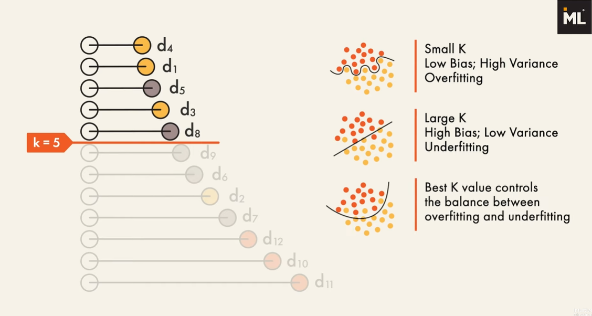

Slide 111
Support Vector Machines:
Support Vector Machines (SVM) is a powerful supervised machine learning algorithm used for classification and regression tasks. The primary objective of SVM is to find the optimal hyperplane that best separates different classes in the feature space.
The goal of the SVM algorithm is to create the Best line or decision boundary that can segregate the n-dimensional space into classes so that we can easily put the new data point in the correct category in the future.
SVM is a model, which can do linear classification as well as regression. SVM is based on the concept of a surface, called a hyperplane, which draws a boundary between data instances plotted in the multi-dimensional feature space. The output prediction of an SVM is one of two conceivable classes which are already defined in the training data. In summary, the SVM algorithm builds an N-dimensional hyperplane model that assigns future instances into one of
the two possible output classes.
Note:
The SVM model is does not depends on the single Hyperplane. Instead it will create 2 more hyperplane where, one is created which is passing through the nearest point in one class or category and one more is for another classs or category.

Slide 112
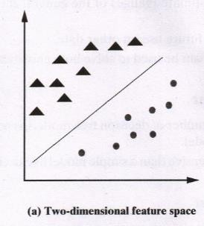
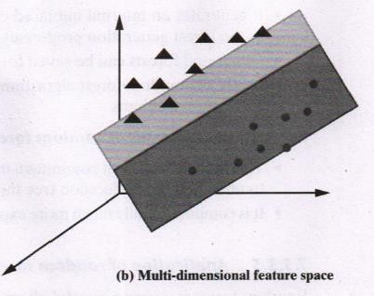
Classification using hyperplanes:
In SVM, a model is built to discriminate or differentiate the data instances belonging to different classes.
Let us assume for the sake of simplicity that the data instances are linearly separable. In this case, when mapped in a two-dimensional space, the data instances belonging to different classes fall in different sides of a straight line drawn in the two dimensional space as depicted in Figure (a).
If the same concept is extended to a multi-dimensional feature space, the straight line dividing data instances belonging to different classes transforms to a hyperplane as depicted in Figure (b). Thus, an SVM model is a representation of the input instances as points in the feature space, which are mapped so that an apparent gap between them divides the instances of the separate classes.
In other words, the goal of the SVM analysis is to find a plane, or rather a hyperplane, which separates the instances on the basis of their classes. New examples (i.e. new instances) are then mapped into that same space and predicted to belong to a class on the basis of which side of the gap the new instance will fall on. In summary, in the overall training process, the SVM algorithm analyses input data and identifies a surface in the multidimensional feature space called the hyperplane. There may be many possible hyperplanes, and one of the challenges with the SVM model is to find the optimal hyperplane.

Slide 113
Important Terminologies:
Marginal Plane: In Support Vector Machines (SVM), the marginal plane refers to the hyperplane or decision boundary that maximizes the margin between the support vectors of different classes. The margin is the distance between the decision boundary and the closest data points (support vectors) from each class.
Support Vectors: The data points which are passing through the Marginal Plane is called Support Vectors. It is possible to have more than one Data Points.
Marginal Distance :In Support Vector Machines (SVM), the marginal distance refers to the distance between the data point and the decision boundary (hyperplane) of the SVM model.
Higher the marginal distance is more the Generalized our Model is.

Slide 114
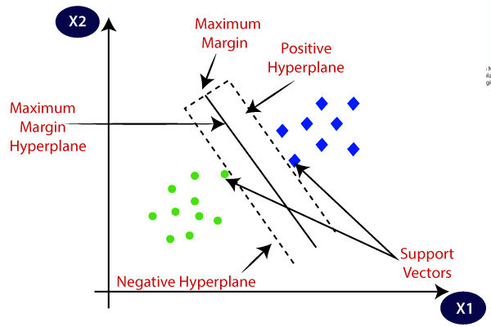
Marginal plane
Note: To Draw a Marginal Plane to circle, Consider a circle which is near to or close to the square. Similarly, to draw Marginal plane to square consider the square near to the circle class.

Slide 115
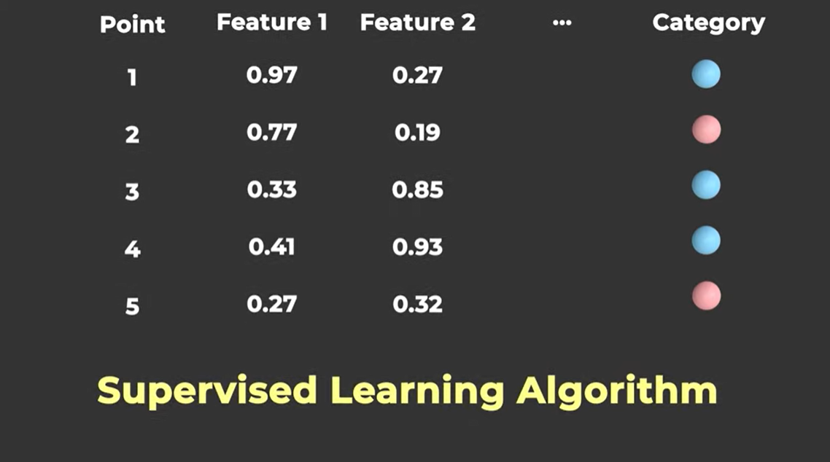

Slide 116
Important to Note:
Support Vector Machines (SVMs) classify new data points by determining which side of the hyperplane they fall on. After the SVM has been trained on a dataset and has identified the optimal hyperplane that separates the classes, it uses this hyperplane to make predictions on unseen data.
When a new data point is presented to the SVM for classification, the model evaluates the position of the point relative to the hyperplane. If the point lies on one side of the hyperplane, it is classified as belonging to one class; if it lies on the other side, it is classified as belonging to the other class. The distance of the data point from the hyperplane determines the confidence level of the classification.
let's consider a simple example where we have two classes: red and blue points distributed in a two-dimensional space. The goal is to train an SVM to classify new data points as either red or blue based on their features.
Suppose we have the following training data:
Red points: (1, 2), (2, 3), (3, 3)
Blue points: (2, 1), (3, 2), (4, 1)
After training the SVM, it finds the optimal hyperplane that separates the red and blue points in the feature space. Let's say the equation of this hyperplane is:
2X1​ + 3X2​=8

Slide 117
Now, when a new data point, let's say (2.5, 2.5), is presented to the SVM for classification, the SVM evaluates its position relative to the hyperplane.
If the point lies above the hyperplane (i.e., 2×2.5+3×2.5>8), it will be classified as a red point.
If the point lies below the hyperplane (i.e., 2×2.5+3×2.5<8), it will be classified as a blue point.
In this way, the SVM classifies new data points based on which side of the hyperplane they fall on.

Slide 118
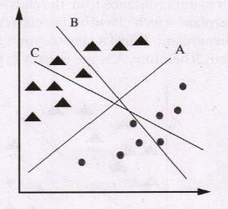
Identifying the correct hyperplane in SVM
There may be multiple options for hyperplanes dividing the data instances belonging to the different classes. We need to identify which one will result in the best classification. Let us examine a few scenarios before arriving to that conclusion. For the sake of simplicity of visualization, the hyperplanes have been shown as straight lines in most of the diagrams.
Scenario 1:
As depicted in Figure, in this scenario, we have three hyperplanes: A, B, and C. Now, we need to identify the correct hyperplane which better segregates the two classes represented by the triangles and circles. As we can see, hyperplane ‘A’ has performed this task quite well.

Slide 119
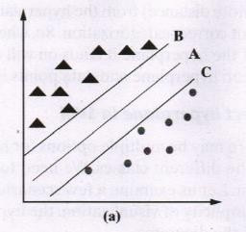

Scenario 2:
As depicted in figure below, we have three hyperplanes: A, B, and C. We have to identify the correct hyperplane which classifies the triangles and circles in the best possible way. Here, maximizing the distances between the nearest data points of both the classes and hyperplane will help us decide the correct hyperplane. This distance is called as margin.
We can see that the margin for hyperplane A is high as compared to those for both B and C. Hence, hyperplane A is the correct hyperplane.
Another quick reason for selecting the hyperplane with higher margin (distance) is robustness. If we select a hyperplane having a lower margin (distance), then there is a high probability of misclassification.

Slide 120

Scenario 3:
When we use the rules as discussed in the previous section to identify the correct hyperplane in the scenario shown in Figure there may a chance of selecting hyperplane B as it has a higher margin (distance from the class) than A. But, here is the catch; SVM selects the hyperplane which classifies the classes accurately before maximizing the margin. Here, hyperplane B has a classification error, and A has classified all data instances correctly. Therefore, A is the correct hyperplane.

Slide 121


Scenario 4:
In this scenario, as shown in Figure a, it is not possible to distinctly segregate the two classes by using a straight line, as one data instance belonging to one of the classes (triangle) lies in the territory of the other class (circle) as an outlier. One triangle at the other end is like an outlier for the triangle class. SVM has a feature to ignore outliers and find the hyperplane that has the maximum margin. Hence, we can say that SVM is robust to outliers. So Consider the Figure b as the Final Hyperplane.

Slide 122
Decision Tree :
Decision tree learning is one of the most widely adopted algorithms for classification. As the name indicates, it builds a model in the form of a tree structure.
It has a hierarchical tree structure consisting of a root node, branches, internal nodes, and leaf nodes. Decision trees are used for classification and regression tasks, providing easy-to-understand models.
Its grouping exactness is focused with different strategies, and it is exceptionally productive. A decision tree is used for multi-dimensional analysis with multiple classes. It is characterized by fast execution time and ease in the interpretation of the rules.
Properties of Decision Tree:
The goal of decision tree learning is to create a model based on the past data called past vector that predicts the value of the output variable based on the input variables in the feature vector.
Each node (or decision node) of a decision tree corresponds to one of the feature vector.
From every node, there are edges to children, wherein there is an edge for each of the possible values (or range of values) of the feature associated with the node.
The tree terminates at different leaf nodes (or terminal nodes) where each leaf node represents a possible value for the output variable.
The output variable is determined by following a path that starts at the root and is guided by the values of the input variables.

Slide 123
Algorithm for decision tree
Step-1: Begin the tree with the root node, says S, which contains the complete dataset.
Step-2: Find the best attribute in the dataset using Attribute Selection Measure (ASM).
Step-3: Divide the S into subsets that contains possible values for the best attributes.
Step-4: Generate the decision tree node, which contains the best attribute.
Step-5: Recursively make new decision trees using the subsets of the dataset created in
step -3: Continue this process until a stage is reached where you cannot further classify the nodes and called the final node as a leaf node.

Slide 124

A Decision tree is usually represented in the format given Below

Slide 125
Building a decision tree:
Decision trees are built corresponding to the training data following an approach called recursive partitioning. The approach splits the data into multiple subsets on the basis of the feature values. It starts from the root node, which is nothing but the entire data set. It first selects the feature which predicts the target class in the strongest way. The decision tree splits the data set into multiple partitions, with data in each partition having a distinct value for the feature based on which the partitioning has happened. This is the first set of branches. Likewise, the algorithm continues splitting the nodes on the basis of the feature which helps in the best partition. This continues till a stopping criterion is reached.
The usual stopping criteria are:
1. All or most of the examples at a particular node have the same class
2. All features have been used up in the partitioning
3. The tree has grown to a pre-defined threshold limit

Slide 126


Slide 127

Example of Decision Tree
Decision trees are upside down which means the root is at the top and then this root is split into various several nodes. Decision trees are nothing but a bunch of if-else statements in layman terms. It checks if the condition is true and if it is then it goes to the next node attached to that decision.

Slide 128

In the below diagram the tree will first ask what is the weather? Is it sunny, cloudy, or rainy? If yes then it will go to the next feature which is humidity and wind. It will again check if there is a strong wind or weak, if it’s a weak wind and it’s rainy then the person may go and play.
All the Non-Leaf Nodes are Features

Slide 129
Example: Build a decision tree using the give data:
Choosing the root node: We start by selecting the feature that best splits the data. We can use metrics like Gini impurity or information gain to measure the effectiveness of each feature. In this case, let's choose "Can fly" as the root node because it best separates birds from mammals.
Splitting the data: We partition the dataset based on the values of the selected feature. For "Can fly," we have two branches: "Yes" and "No."
3. Repeat: We repeat the process for each branch, selecting the best feature to split the data until we reach a stopping criterion (e.g., maximum depth, minimum number of samples per leaf).
Animal | Has fur (Hair) | Has feathers | Lays eggs | Can fly | Type
Dog | Yes | No | No | No | Mammal
Eagle | No | Yes | No | Yes | Bird
Platypus | Yes | No | Yes | No | Mammal
Sparrow | No | Yes | No | Yes | Bird
Bat | Yes | No | No | Yes | Mammal
Ostrich | No | Yes | Yes | No | Bird

Slide 130
Can fly?
Yes
No
Bird
Has fur?
Yes
No
Mammal
Has feathers?
Yes
No
Bird
Mammal

Slide 131
Challenges in implementing the decision tree
Overfitting:
Decision trees can get too specific to the training data, capturing noise instead of true patterns. Imagine trying to memorize all answers to a quiz, including the wrong ones, instead of understanding the concepts.
Overfitting occurs when a machine learning model learns the training data too well, but fails to generalize to new, unseen data.
2. Choosing the Right Questions (Features):
Deciding which question to ask at each step (like "Can it fly?") can be tricky. If we ask the wrong questions, we won't get closer to the correct answer. It's like playing a guessing game where some questions are more useful than others.
3. Handling Continuous Information:
Decision trees prefer categorical (yes/no) questions, so dealing with continuous information, like temperature, requires converting it into categories (hot, cold, warm).
4. Data Imbalance: If there are far more examples of one class than another, the tree might favor the majority class, ignoring the minority. It's like a classroom where the teacher only pays attention to the rowdy students, neglecting the quiet ones.

Slide 132
5. Complexity and Time:
Building a decision tree can take a lot of time, especially if there are many features or a large dataset. It's like drawing a very intricate map – the more details you include, the longer it takes to finish.
6. Making Sense of the Tree: While decision trees are easy to understand visually, complex trees can become like tangled branches, making it hard to see the overall structure. It's like trying to navigate a forest with too many trees blocking your view.
7. Handling Missing Information: Decision trees don't handle missing data well. If some information is missing, it's like trying to answer a question without all the necessary clues.
8. Balancing Simplicity and Accuracy: Sometimes, simpler trees are better because they generalize well to new data. Finding the right balance between a simple and accurate tree is like finding the perfect recipe – not too complicated, but not missing any key ingredients.

Slide 133


Slide 134

Random Forest:
Random forest is an ensemble classifier, i.e. a combining classifier that uses and combines many decision tree classifiers. It is also used for Regression.
Random Forest combines the output of multiple decision trees to reach a single result. It combines the opinions of many “trees” i.e, individual models to make better predictions, creating a more robust and accurate overall model.
Full
Random Subset-1
Random Subset-2
Random Subset-N
Note: Random Subset includes both Random Subset of the Full Dataset as well as Random Features from the Full Dataset

Slide 135
Working of the Random Forest Model:
Random Forest is a popular group learning method that builds multiple Decision trees and aggregates their outcomes or output to make a final prediction.
It works by creating a set of decision trees, where each tree is trained on a randomly selected subset of the training data and a randomly selected subset of features. (Sampling)
The final prediction is then made by aggregating the prediction of all the trees on the basis of the majority votes from the 'n' trees. The randomness in selecting the data and feaures helps to increase the accuracy of the model.

Slide 136
Random Forest algorithm :
If there are N variables or features in the input data set, select a subset of ‘m’ (m<N) features at random out of the N features. Also, the observations or data instances should be picked randomly.
Use the best split principle on these ‘m’ features to calculate the number of nodes ‘d’
Keep splitting the nodes to child nodes till the tree is grown to the maximum possible extent.
Select a different subset of the training data ‘with replacement’ to train another decision tree following steps (1) to (3). Repeat this to build and train ‘n’ decision trees.
Final class assignment is done on the basis of the majority votes from the ‘n’ trees.

Slide 137

Example:

Slide 138
Why Random Forest When we have Decision tree Model?
The main reason for this is the drawback or Limitations with Decision Tree that is Overfitting which means it has Low Bias and High Variance. To avoid these kind of problem a model came into picture which is called as Random Forest method. So the Random Forest method will give Low Bias and Low Variance, So in order to get a optimal output we need these two.
1. Low Bias – Low Training Error
2. High Variance – High Testing Error

Slide 139
Regression:
Regression is a type of supervised machine learning task where the goal is to predict a continuous numerical value or outcome based on input features.
Regression is a type of supervised machine learning where algorithms learn from the data to predict continuous values such as sales, salary, weight, or temperature.
Let us take the example of real estate to understand the concept of regression. To know the price of an apartment, if we can build a model which can predict the correct value of a real estate if it has certain standard inputs such as area (sq. m.) of the property, location, floor, amenities available etc., then we can solve real estate price prediction problem.
Many problems related to prediction of numerical value can be solved using the regression model. In the context of regression, dependent variable (Y) is the one whose value is to be predicted. This variable is presumed to be functionally related to one (say, X) or more independent variables called predictors. In other words, the dependent variable depends on independent variable(s) or predictor(s).
Regression is essentially finding a relationship (or) association between the dependent variable (Y) and the independent variable(s) (X), i.e. to find the function ‘f’ for the association Y = f (X).

Slide 140
Example:
Linear Regression:
Predicting the salary of an employee on the basis of the year of experience.

Slide 141
Common Regression Algorithms:
The most common regression algorithms are as follows:
Simple linear regression
Multiple linear regression
Polynomial regression
Multivariate adaptive regression splines
Logistic regression
Maximum likelihood estimation (least squares)

Slide 142

Simple linear regression:
As the name indicates, simple linear regression is the simplest regression model which involves only one independent variable or predictor and only one Dependent Variable or the Response Variable.
This model assumes a linear relationship between the dependent variable and the predictor variable i.e, The relationship between Dependent and Independent Variable is Linear. Here Linear means if the value of independent variable increases or decreses then the value of Dependent varible will increases or decreases for sure.
Note:
When we are trying to predict a categorical or nominal variable, the problem is known as a classification problem. A classification problem is one where the output variable is a category such as ‘red’ or ‘blue’ or ‘malignant tumour’ or ‘benign tumour’ etc. Whereas when we are trying to predict a numerical variable such as ‘price’, ‘weight’, etc. the problem falls under the category of regression.

Slide 143


Slide 144

Working of Simple Linear Regression:
The Working of Simple Linear Regression is very Simple that it will draw a straight line in a 2D Plane which is called Best Fit Line. So our aim is to find the Best Fit Line with minimal Error.
Let’s Take an Example of Height and Weight such that the Problem is to Find a Height of a Person given the Weight.
Note: Best Fit Line is draws based on the Slope of the Line
Best Fit Line
Height
Weight
https://www.youtube.com/watch?v=jerPVDaHbEA

Slide 145

Important Terminology:
Y-Intercept:
The y-intercept represents the point where the regression line intersects the y-axis. It is the value of the dependent variable (y) when all independent variables (x) are equal to zero.

Slide 146

What is Slope of the Line (b) in the Equation: Y = a + bX
Slope of the line indicates that 1 unit of increase in X is effecting the increase of slope in y.

Slide 147
Error in simple regression:
The regression equation model in machine learning uses the above slope—intercept format in algorithms. X and Y values are provided to the machine, and it identifies the values of a (intercept) and b (slope) by relating the values of X and Y. However, identifying the exact match of values for a and b is not always possible. There will be some error value (¢) associated with it. This error is called marginal or residual error.
ŷ=(a+bX) + ε

Slide 148
Multiple Linear Regression:
In a multiple regression model, two or more independent variables, i.e. predictors are involved in the model. In the context of simple linear regression, we considered Price of a Property as the dependent variable and the Area of the Property (in sq. m.) as the predictor variable.
However, location, floor, number of years since purchase, amenities available, etc. are also important predictors which should not be ignored. Thus, if we consider Price of a Property (in ₹) as the dependent variable and Area of the Property (in sq.m.), location, floor, number of years since purchase and amenities available as the independent variables, we can form a multiple regression equation as shown below:
Priceproperty = f (Areaproperty, location, floor, Ageing, Amenities)
The simple linear regression model and the multiple regression model assume that the dependent variable is continuous.
The following expression describes the equation involving the relationship with two predictor variables, namely X1 and X2.
ŷ ​=a + b1​X1​ + b2​X2​

Slide 149

The model describes a plane in the three-dimensional space of Y^, X1 and X2. Parameter ‘a’ is the intercept of this plane. Parameters ‘b1’ and ‘b2’ are referred to as partial regression coefficients.
Parameter b1 represents the change in the mean response corresponding to a unit change in X1 when X2is held constant. Parameter b2 represents the change in the mean response corresponding to a unit change in X2 when X1 is held constant.
Multiple regression for estimating equation when there are ‘n’ predictor variables is as follows:
​ ŷ =a+ b1​X1 ​+ b2​X2​ +…+ bn​Xn​

Slide 150

Polynomial Regression Model: Polynomial regression model is the extension of the simple linear model.
Why Polynomial Regression?
A simple linear regression algorithm only works when the relationship between the data is linear. But suppose we have non-linear data, then linear regression will not be able to draw a best-fit line. Simple regression analysis fails in such conditions. Consider the below diagram, which has a non-linear relationship, and you can see the linear regression results on it, which does not perform well, meaning it does not come close to reality. Hence, we introduce polynomial regression to overcome this problem, which helps identify the curvilinear relationship between independent and dependent variables.
Linear Relationship:
A linear relationship between two variables means that when one variable changes, the other variable changes in a straight-line fashion. In other words, if you were to plot the relationship between the two variables on a graph, the points would form a straight line.
That is, In a linear relationship between two variables, when the value of one variable increases, the value of the other variable also increases if the relationship is positive. Conversely, if the relationship is negative, when the value of one variable increases, the value of the other variable decreases.
https://www.youtube.com/watch?v=QptI-vDle8Y

Slide 151
Polynomial regression is a form of regression analysis in machine learning (ML) where the relationship between the independent variable X and the dependent variable Y is modeled as an n-degree polynomial. Unlike simple linear regression, which fits a straight line to the data, polynomial regression can capture more complex relationships between variables by introducing polynomial terms.
The general form of a polynomial regression model with one independent variable X can be expressed as:
Polynomial with Degree or Order n:
y = b0 + b1X + b2X² + ....... + bnX^{n} + ε
where:
y is the dependent variable,
x is the independent variable,
b0, b1, b2,…………..bn​ are the coefficients,
n is the l,
ε is the error term.

Slide 152
Polynomial Terms:
Polynomial terms refer to mathematical expressions involving variables raised to powers and multiplied by coefficients. In the context of polynomial regression or polynomial functions, these terms are used to model relationships between variables that are not linear.
A polynomial term typically takes the form ax^{n},
where:
a is a coefficient (a constant multiplier),
x is the variable,
n is a non-negative integer representing the degree of the term (the exponent to which the variable is raised).

Slide 153


Slide 154


Slide 155


Slide 156
Note:
y = b0 + b1X1 + b2X1² + ....... + bnX1^{n} +ε
This is Your Ploynomial Equation, and Imagine it as below:
y = b0X1⁰ + b1X1¹ + b2X1² + ....... + bnX1^{n} +ε

Slide 157
Logistic Regression:
Logistic regression is a versatile technique that serves both classification and regression tasks, depending on the context in which it is applied. It's primarily utilized as a classification method and is often referred to as logit regression.
This statistical approach is employed for predicting the outcome of a categorical dependent variable. In logistic regression, the dependent variable (Y) typically takes on binary values (0 or 1), representing two possible outcomes. Meanwhile, the independent variables (X) are continuous in nature, providing predictive features for the model.
Logistic regression is used when our dependent variable is dichotomous or binary. It just means a variable that has only 2 outputs, for example, A person will survive this accident or not, The student will pass this exam or not. The outcome can either be yes or no (2 outputs). This regression technique is similar to linear regression and can be used to predict the Probabilities for classification problems. Like all regression analyses, logistic regression is a predictive analysis.

Slide 158
Here's how logistic regression works:
Binary Classification Task: Logistic regression is primarily used for binary classification, where the target variable y has only two possible outcomes (e.g., 0 or 1, "Yes" or "No", "True" or "False").
Sigmoid Function: Logistic regression applies the logistic function also called the sigmoid function to transform the output of a linear equation into a value between 0 and 1.
Logistic Regression is similar to Linear Regression Except Logistic Regression predicts whether something is 0 or 1 i.e, True or False, Instead of predicting something continuous like size, house price, salary etc.
The logistic regression model works by transforming the Linear Regression equation using a Logistric Function, which maps any value between -∞ to +∞ to a range between 0 and 1. The logistic funtion used in Logistic Regression is called as Sigmoid and it's equation is as follows.
ln( P/ 1-P ) = a + bX
ln(P/1 - P) = β0 + β1X1 + β2X2+ .....+ βnXn
The Logistic formula are stated in terms of the probability that Y=1 which is referred as P and the Probability that Y = 0 is 1-P
https://www.youtube.com/watch?v=yIYKR4sgzI8&t=13s

Slide 159

Best Fit Line
Height
Weight

Slide 160

Also, instead of fitting a line to the data, logistic regression fits an "S" shaped "Logistic Function" or "Sigmoid Function".

Slide 161

One Diff between Linear and Logistic regression is how the Line is Fit to the Data.

Slide 162


Slide 163
Unsupervised Learning:
Unsupervised Machine learning is a type of machine learning where the algorithm is trained on unlabeled data, and the objective is to find patterns, relationships, or structures within the data without explicit guidance or labeled outcomes. i.e Unsupervised learning is a method we use to group data when no labels are present.
As the name suggests, unsupervised learning is a machine learning technique in which models are not supervised using training dataset. Instead, models itself find the hidden patterns and insights from the given data. It can be compared to learning which takes place in the human brain while learning new things.
It can be defined as: “Unsupervised learning is a type of machine learning in which models are trained using unlabeled dataset and are allowed to act on that data without any supervision.”
Unsupervised learning cannot be directly applied to a regression or classification problem because unlike supervised learning, we have the input data but no corresponding output data.
Example:
Suppose the unsupervised learning algorithm is given an input dataset containing images of different types of cats and dogs. The algorithm is never trained upon the given dataset, which means it does not have any idea about the features of the dataset. The task of the unsupervised learning algorithm is to identify the image features on their own based on that it will classify or clusters the new data . Unsupervised learning algorithm will perform this task by clustering the image dataset into the groups according to similarities between images. These models will never make a predictions as in Supervised Learning Model.

Slide 164
Why use Unsupervised Learning?
Unsupervised learning is helpful for finding useful insights from the data.
Unsupervised learning is much similar as a human learns to think by their own experiences, which makes it closer to the real AI.
Unsupervised learning works on unlabeled and uncategorized data which make unsupervised learning more important.
In real-world, we do not always have input data with the corresponding output so to solve such cases, we need unsupervised learning.
Semi-supervised Learning: Unsupervised ML techniques can also be combined with supervised ML in semi-supervised learning approaches. In this paradigm, a small amount of labeled data is augmented with a larger amount of unlabeled data to improve the performance of supervised models.
Note:
Unsupervised machine learning (ML) works differently from supervised ML because it doesn't rely on labeled data to learn patterns or make predictions. Instead, unsupervised ML algorithms focus on finding hidden structure or patterns within the data without explicit guidance from predefined labels.

Slide 166
Here, we have taken an unlabeled input data, which means it is not categorized and corresponding outputs are also not given. Now, this unlabeled input data is fed to the machine learning model in order to train it. Firstly, it will interpret the raw data to find the hidden patterns from the data and then will apply suitable algorithms such as k-means clustering, Decision tree, etc. Once it applies the suitable algorithm, the algorithm divides the data objects into groups according to the similarities and dissimilarities between the objects.
Working of Unsupervised learning models:
We feed the model data with no categories or outputs for training
Model interprets raw data to identify hidden patterns
Depending on data, we use suitable algorithms
Algorithm groups data

Slide 167
Disadvantages of Unsupervised Learning:
1. Unsupervised learning is fundamentally more difficult than supervised learning since it lacks comparable results.
2. The outcome of an unsupervised learning approach may be less accurate since the input data does not have labels and algorithms do not know the precise output in advance.
3. We need humans to validate the results of unsupervised learning models which convolutes the process.
4. The operations involved require a high level of computational power and also take up a lot of time.
Alternative to Unsupervised Learning:
Semi-supervised learning may be a viable alternative to unsupervised learning. It is a combination or even a min-and-match of both unsupervised and supervised learning methods. The primary benefit of this sort of training would be that it lowers errors.
For example, it will only cluster the unlabeled data that fits the clustering criteria, and it will categorize the output automatically once it has labels. This uses less computer power and takes less time.

Slide 168
Supervised Learning Vs. Unsupervised Learning:
Aspect | Supervised Learning | Unsupervised Learning
Definition | Learning from labeled data, where input-output pairs are given. | Learning from unlabeled data, where the algorithm must infer patterns without explicit output labels.
Objective | To predict or classify new data based on past observations. | To discover hidden patterns or structures in data.
Input Data | Requires labeled data (input-output pairs). | Works with unlabeled or unstructured data.
Feedback | Receives feedback during training (error or loss function). | No feedback during training; relies on inherent data properties.
Types | Classification, Regression. | Clustering, Dimensionality Reduction, Association.
Usage | Use Off-line analysis of Data. | Use Real-Time analysis of Data.
Training Complexity | Often more complex due to the need for labeled data. | Generally simpler as it doesn't require labeled data.
Applicability | Commonly used in tasks where labeled data is available. | Used when there's no labeled data or to explore data structure.
Examples of Algorithms | Decision Trees, Support Vector Machines, Neural Networks. | K-Means, Hierarchical Clustering, Principal Component Analysis (PCA).

Slide 169
Types of Unsupervised Learning:
1. Clustering
2. Association rules
3. Dimensionality reduction.

Slide 170
Clustering:
Clustering methods involve grouping untagged data based on their similarities and differences. When two instances appear in different groups, we can infer they have dissimilar properties.
Clustering is a type of unsupervised learning, meaning that we do not need labeled data for clustering algorithms; this is one of the biggest advantages of clustering over other supervised learning like Classification.
Clustering is the process of arranging a group of objects in such a manner that the objects in the same group (which is referred to as a cluster) are more similar to each other than to the objects in any other group.
OR

Slide 171

Clustering as a machine learning task :
The primary driver of clustering knowledge is discovery rather than prediction, because we may not even know what we are looking for before starting the clustering analysis. So the model tries to discover hidden patterns from the dataset.
So, clustering is defined as an unsupervised machine learning task that automatically divides the data into clusters or groups of similar items. The analysis achieves this without prior knowledge of the types of groups required and thus can provide an insight into the natural groupings within the data set. The primary guideline of clustering task is that the data inside a cluster should be very similar to each other but very different from those outside the cluster.
We can assume that the definition of similarity might vary across applications, but the basic idea is always the same, that is, to create the group such that related elements are placed together.
Using this principle, whenever a large set of diverse and varied data is presented for analysis, clustering enables to represent the data in a smaller number of groups. It helps to reduce the complexity and provides insight into patterns of relationships to generate meaningful and actionable structures within the data. The effectiveness of clustering is measured by the homogeneity within a group as well as the difference between distinct groups.

Slide 172
Different Types of Clustering Techniques
The major clustering techniques are
Partitioning methods
k-means
kmedoid.
Hierarchical methods
Agglomerative Hierarchical Clustering
Divisive Hierarchical Clustering
Density-based methods
DBSCAN

Slide 173
Partitioning methods:
Partitioning methods aim to divide the data points into distinct non-overlapping subgroups or clusters. Each data point belongs to exactly one cluster.
Two of the most important algorithms for partitioning-based clustering are:
k-means (A centroid-based technique)
kmedoid
In the k-means algorithm, the centroid of the prototype is identified for clustering, which is normally the mean of a group of points. Similarly, the k-medoid algorithm identifies the medoid which is the most representative point for a group of points. We can also infer that in most cases, the centroid does not correspond to an actual data point, whereas medoid is always an actual data point.

Slide 174
k-Means Clustering: (A centroid-based technique):
K-Means is one of the most popular unsupervised machine learning algorithms used for clustering. The algorithm aims to partition a set of data points into 'k' clusters, where each data point belongs to the cluster with the nearest mean or centroid.
The goal of clustering is to divide the population or set of data points into a number of groups so that the data points within each group are more comparable to one another and different from the data points within the other groups. It is essentially a grouping of things based on how similar and different they are to one another.
The principle of the k-means algorithm is to assign each of the ‘n’ data points to one of the K clusters where ‘K’ is a user-defined parameter as the number of clusters desired. The objective is to maximize the Homogeneity within the clusters and also to maximize the differences between the clusters. The homogeneity and differences are measured in terms of the distance between the objects or points in the data set.

Slide 175
What the Means indicates in the Name K-Means:
In the context of the k-Means algorithm, "Means" refers to the centroids of the clusters.
The word "Means" comes from the fact that in the k-Means algorithm, each cluster is represented by the mean or average of all the data points assigned to that cluster. These means are also called centroids.
During each iteration of the algorithm, the centroids are recalculated to update their positions based on the current assignment of data points to clusters. The centroids are computed as the average of the data points belonging to each cluster.
For example, suppose you have a cluster of two-dimensional points with the following coordinates:
(1, 3), (2, 4), (3, 5)
To find the centroid of this cluster, you would calculate the mean of the x-coordinates and the mean of the y-coordinates separately:
Mean x-coordinate = (1 + 2 + 3) / 3 = 2
Mean y-coordinate = (3 + 4 + 5) / 3 = 4
So, the centroid of this cluster would be the point (2, 4). This point represents the "mean" or "average" location of the data points in that cluster.

Slide 176
Simple algorithm of K-means:
Step 1:
Choose the number of clusters, 'k', that you want to identify.
Randomly initialize 'k' cluster centroids.
Loop
Step 2: Assign each point in the data space to the nearest centroid to form K clusters
Step 3: Measure the distance of each point in the cluster from the centroid
Step 4: Calculate the Sum of Squared Error (SSE) to measure the quality of the clusters.
This is to measure whether the K value is good or bad.
Step 5: Identify the new centroid of each cluster on the basis of distance between points Step 6: Repeat Steps 2 to 5 to refine until centroids do not change.
End Loop.

Slide 177

Example: Let’s say we are given the Data Set as below. Which has 2 Feature X and Y. Now the Task is to Identify the Clusters.
https://www.youtube.com/watch?v=EItlUEPCIzM

Slide 178

Final Output

Slide 179



Slide 180

Step-1: Initialize Hyperparameter K value. In this example it is 2.

Slide 181

Now, the next step is to find the distance between the data point and the given Centroids and cluster them accordingly. So, The best way to find the distance is by using a straight line as shown below or using Euclidian Distance. Here we used the Line, So this will divide the data points into two section like left and right. So we got 2 imperfect clunky clusters.

Slide 182

Now, we will try to adjust the Centroid, So that the cluster will be more better than the initial one.
For Example: Now, we got 2 initial clusters which are not proper. So place the centroid of that cluster into the center of the cluster

Slide 183

Repeat the Same steps until we get a Cluster with Proper Data points. Which means until the datapoint change its cluster after the adjustment.

Slide 184

We have to keep on repeating this process, like recalculate the centroids, then recalculate the distance from each individual data points to these centroids, and readjust the clusters, Until the point that none of the data point changes the Cluster.

Slide 185

This is the Final Clustering which satisfies the Condition.

Slide 186


Slide 187

How to Determine Correct Number of Clusters (K): (Elbow Method)
Find Sum of Squared Errors (SSE) for Each Cluster in Each Iteration.
Which means For each of the cluster you try to compute the distance of individual data point from the centroid and then square it and sum it up. Do the same for all of the clusters you have and at the end you will get the following: SSE1 + SSE2 + ………… + SSEk

Slide 188

Once we get SSE for all the Clusters then we will plot a graph as below to find the Elbow which indicates the best number of cluster to consider or take initially.

Slide 189
k-Medoids Cluster:
The k-Medoids algorithm is a variation of the k-Means algorithm that focuses on finding representative objects or medoids in the dataset to form clusters. Instead of using the mean or centroid of the data points within a cluster, the k-Medoids algorithm selects actual data points or medoids as cluster representatives. This makes the k-Medoids algorithm more robust to outliers compared to k-Means, as it directly uses data points as cluster centers rather than relying on the mean, which can be sensitive to outliers.
Because of the use of medoids from the actual representative data points, k-medoids is less influenced by the outliers in the data. One of the practical implementation of the k-medoids principle is the Partitioning Around Medoids (PAM) algorithm.
What Do you mean by medoids:
A medoid in a data set is a central point within a cluster minimizing the sum of distances to the other point.
Outliers:
Outliers refer to data points that significantly differ from other observations in a dataset.
For Example in a dataset of student exam scores where most students score between 60 and 90, but there is one student who scores 10. This score of 10 would be considered an outlier because it significantly differs from the rest of the scores in the dataset.

Slide 190
There are 2 Type of K-Medoid Clustering Algorithm:
Partitioning Around Medoids (PAM)- Suitable for Small Datsets
CLustering LARge Application (CLARA) – Large Data Sets
PAM:
Step 1: Initially Select k Random points as the medoid or representative points from the given n data points of the data set.
loop
Step 2: Assign each of the remaining points to the cluster which has the nearest representative point by finding the distance using Euclidian Distance or other.
Step 3: Randomly select a non-representative point or, in each cluster
Step 4: Swap the representative point oj with or, and compute the new SSE after swapping
Step 5: If SSEnew < SSEold, then swap oj with or, to form the new set of k representative objects;
Step 6: Refine the k clusters on the basis of the nearest representative point.
Logic continues until there is no change
end loop

Slide 191

Implementation: (Not Suitable for Large Dataset)
Step-1: Initially Select k Random points as the medoid or representative points from the given n data points of the data set.
Step-2: Associate each data point to the closest medoid by using any of the most common distance metrics. For example Euclidian Or Manhatten Distance.
Step-3: Once the Cluster is formed then we have to calculate the Total Cost of forming these Clusters. So calculate the total cost as the total sum of the distacne of the data points from the assigned medoid. The Cost is nothing but sum of the distances of all points from the medoid of the cluster they belongs to.
Where,
Ci : Cluster Number (C1, C2, ….. , Cn) which is nothing but the Medoid
Pi : is the data point
| |: Cardinality to consider only +ve value.
Step-4: Swap one medoid point with a non-medoid point and recalculate the cost.
Step-5: If the calculated cost with new medoid point is grater than the previous cost, we undo the swap and the algorithm coverges else; we repeat step 4
https://www.youtube.com/watch?app=desktop&v=OFELCn-6r2o
https://youtu.be/ChBxx4aR-bY?si=XamwvU5lU0fvUjV_

Slide 192


Slide 193
2. Hierarchical clustering:
Hierarchical clustering is a clustering technique used in unsupervised machine learning to group similar data points into clusters that form a hierarchy. Unlike k-Means, which requires the number of clusters to be specified beforehand, hierarchical clustering does not require the number of clusters to be predefined. Instead, it organizes the data points into a tree-like structure, called a dendrogram, based on their similarities.
The hierarchical clustering methods are used to group the data into hierarchy or tree-like structure.
For example, in a machine learning problem of organizing employees of a university in different departments, first the employees are grouped under the different departments in the university, and then within each department, the employees can be grouped according to their roles such as professors, assistant professors, supervisors, lab assistants, etc. This creates a hierarchical structure of the employee data and eases visualization and analysis. Similarly, there may be a data set which has an underlying hierarchy structure that we want to discover and we can use the hierarchical clustering methods to achieve that.

Slide 194

There are two main approaches to hierarchical clustering:
Agglomerative Hierarchical Clustering
Divisive Hierarchical Clustering
Agglomerative Hierarchical Clustering: (Bottom-Up)
The agglomerative hierarchical clustering method uses the bottom-up strategy. It starts with each object forming its own cluster and then iteratively merges the clusters according to their similarity to form larger clusters. It terminates either when a certain clustering condition imposed by the user is achieved or all the clusters merge into a single cluster.
This approach starts by considering each data point as a single-cluster. Then, at each step, it merges the two closest clusters until all data points belong to a single cluster or until a stopping criterion is met. The result is a dendrogram that shows the merging process and allows us to identify clusters at different levels of granularity.

Slide 195


2. Divisive Hierarchical Clustering: (Top-Down)
The divisive hierarchical clustering method uses a top-down strategy. The starting point is the largest cluster with all the objects in it, and then, it is split recursively to form smaller and smaller clusters, thus forming the hierarchy. The end of iterations is achieved when the objects in the final clusters are sufficiently homogeneous to each other or the final clusters contain only one object or the user-defined clustering condition is achieved.

Slide 196
3. Density-based methods – DBSCAN:
Density-based Spatial Clustering of Applications with Noise (DBSCAN) is a popular clustering algorithm in machine learning used for grouping together data points based on their density (mass) in a given feature space. Unlike k-Means, which assumes that clusters are spherical and require the number of clusters to be predefined, DBSCAN can find clusters of arbitrary shapes and sizes without needing the number of clusters as an input.
The density-based clustering approach provides a solution to identify clusters of arbitrary shapes. The principle is based on identifying the dense area and sparse area within the data set and then run the clustering algorithm. DBSCAN is one of the popular density-based algorithm which creates clusters by using connected regions with high density.
DBSCAN is a base algorithm for density-based clustering. It can discover clusters of different shapes and sizes from a large amount of data, which is containing noise and outliers.
Note:
In above para k-Means assumes that clusters are spherical means that the algorithm operates under the assumption that the clusters in the data are spherical in shape when viewed in the feature space. In other words, k-Means assumes that the data points within each cluster are evenly distributed around a central point, forming a roughly spherical cluster. DBSCAN, on the other hand, is capable of identifying clusters of arbitrary shapes and sizes because it defines clusters based on density rather than assuming a specific shape.

Slide 197

Dense and Sparse Area:
In the context of clustering algorithms like DBSCAN (Density-Based Spatial Clustering of Applications with Noise), "dense" and "sparse" areas refer to regions of the dataset with different concentrations of data points.
Dense Area:
A dense area in the dataset is a region where there is a high concentration of data points. In a dense area, data points are closely packed together, and there are relatively many data points within a small area. Dense areas often correspond to clusters in clustering algorithms, as they represent regions where the data points share similar characteristics or properties.
2. Sparse Area:
A sparse area in the dataset is a region where there is a low concentration of data points. In a sparse area, data points are more sparsely distributed, and there are relatively few data points within a given area. Sparse areas often occur between clusters or in regions of the feature space where there is little or no data present.

Slide 198
The DBSCAN algorithm uses two parameters:
minPts: The minimum number of points (a threshold) clustered together for a region to be considered dense.
eps (ε): A distance measure that will be used to locate the points in the neighborhood of any point.
These parameters can be understood if we explore two concepts called :
Density Reachability and
Density Connectivity.
Reachability in terms of density establishes a point to be reachable from another if it lies within a particular distance (eps) from it.
Connectivity, on the other hand, involves a transitivity based chaining-approach to determine whether points are located in a particular cluster. For example, p and q points could be connected if p->r->s->t->q, where a->b means b is in the neighborhood of a.

Slide 199
Algorithmic steps for DBSCAN clustering :
The algorithm proceeds by arbitrarily picking up a point in the dataset (until all points have been visited).
If there are at least ‘minPoint’ points within a radius of ‘ε’ to the point then we consider all these points to be part of the same cluster.
The clusters are then expanded by recursively repeating the neighborhood calculation for each neighboring point

Slide 200

https://www.youtube.com/watch?v=-p354tQsKrs

Slide 202

Step-1: Find the Distance between each point and all the other point in the Data set using Euclidian Distance Formula.

Slide 203


Slide 204

Step-2: Find the nearest data points to each of the given data point. In the given distance table go horizontally 1st and then go for vertically and Consider only those distance from the particular point which is less than eps (ε).

Slide 205

Step-3: Now we have to find the Core, Border and noise data point.

Slide 206

Keep in mind the minPts = 4 value which means consider those group of data points which has more than or equal to 4 data points which are near to each other as Core.

Slide 207

After this we have to find Border which means check whether all the data points which are not Core is a member of any of the Core data point group. If yes those data points are considered as Border and all other points are considered as Nose as they does not belong to any of the CLusters.

Slide 208

Conclusion: Now we got 3 Clusters as the Output for our DBSCAN Algorithm.
Clusters:
P2: P1, P3, P11
P5: P4, P6, P7, P8
P11: P2, P10, P12

Slide 209
ASSOCIATION RULES :
Association rule presents a methodology that is useful for identifying interesting relationships hidden in large data sets. It is also known as association analysis, and the discovered relationships can be represented in the form of association rules comprising a set of frequent items.
A common application of this analysis is the Market Basket Analysis (MBA) where the aim is to find associations between items purchased together, that retailers use for cross-selling of their products.
For example, every large grocery store accumulates a large volume of data about the buying pattern of the customers. On the basis of the items purchased together, the retailers can push some cross-selling either by placing the items bought together in adjacent areas or creating some combo offer with those different product types.
The below association rule signifies that people who have bought bread and milk have often bought egg also; so, for the retailer, it makes sense that these items are placed together for new opportunities for cross-selling.
Market Basket Problem :
The problem of deriving associations from data is of utmost importance in unsupervised learning. This problem is often referred to as Market basket problem.
In this problem, we are given a set of items and a large collection of transactions that are subsets of these items. The task here is to find relationship between the presences of various items within the basket.

Slide 210
Key components of association rules include:
Support: ( Indicates how the items support the Association rule)
Support refers to the frequency or occurrence of a particular itemset in a dataset. It measures how frequently a specific combination of items appears together in the dataset.
Support is used to identify itemsets that occur frequently enough to be considered significant for generating association rules. Higher support values indicate stronger relationships between items.
For example,
let's calculate the support for {Milk, Bread}.
Support({Milk, Bread}) = (Number of transactions containing {Milk, Bread}) / (Total number of transactions)
Support({Milk, Bread}) = 3 / 5 = 0.6
This means that the support for the itemset {Milk, Bread} is 0.6, indicating that it appears in 60% of the transactions.

Slide 211
2. Confidence:
Confidence measures the reliability of the association rule.
Confidence measures the reliability of the inference made by an association rule. It is the probability of seeing the consequent (B) in a transaction given that the transaction also contains the antecedent (A). A high confidence indicates a strong association between the antecedent and consequent.
For example, let's calculate the confidence for the rule {Milk} → {Bread}.
Confidence({Milk} → {Bread}) = (Number of transactions containing {Milk, Bread}) / (Number of transactions containing {Milk})
Confidence({Milk} → {Bread}) = 3 / 4 = 0.75
This means that the confidence for the rule {Milk} → {Bread} is 0.75, indicating that in 75% of the transactions where Milk is purchased, Bread is also purchased.

Slide 212
3. Lift:
Lift measures the degree of association between two items. It compares the likelihood of the two items occurring together in transactions to the likelihood of them occurring independently. Lift tells us how much more often the items appear together than we would expect based on their individual occurrence rates.
A lift value greater than 1 indicates that the two items appear together more often than expected, suggesting a positive association. A lift value less than 1 implies a negative association, meaning the items occur together less frequently than expected.
For example,
let's calculate the lift for the rule {Milk} → {Bread}.
Lift({Milk} → {Bread}) = (Support({Milk, Bread})) / (Support({Milk}) * Support({Bread}))
Lift({Milk} → {Bread}) = (0.6) / (0.8 * 0.8) = 0.75 / 0.64 ≈ 1.17
This means that the lift for the rule {Milk} → {Bread} is approximately 1.17, indicating that customers are about 1.17 times more likely to buy Milk and Bread together than if their purchases were independent.

Slide 213
APRIORI ALGORITHM:
The Apriori algorithm is a classical algorithm used for association rule mining in machine learning and data mining.
It is designed to discover frequent itemsets in transactional databases and derive association rules from these itemsets. The algorithm is named "Apriori" because it uses the "prior" knowledge of frequent itemsets to efficiently generate candidate itemsets.
The main idea for the Apriori algorithm is: All non-empty subsets of a frequent itemset must also be frequent.
The Apriori algorithm detects the most frequent itemsets or elements in a transaction database and establishes association rules between the items. The method employs a “bottom-up” strategy, in which frequent subsets are expanded one item at a time (candidate generation), and groups of candidates are checked against the data. When no more successful rules can be obtained from the data, the algorithm stops.

Slide 214
Algorithm:
It uses Frequent itemsets to generate association rules and it is designed to work on databases that contains transactions.
This algorithm uses the Breadth First Search (BFS) and Hash Tree to calculate the itemset association efficiently.
Step-1: Determine the Support of itemsets and select minimum support and Confidence.
Step-2: Take all the supports in the transaction with higher support value than minimum or selected support value.
Step-3: Find all the rules of these sub itemsets that have higher confidence value than the threshold or decreesing order of Lift

Slide 215
Example:
TId | Itemsets
T1 | A, B
T2 | B, D
T3 | B, C
T4 | A, B, D
T5 | A, C
T6 | B, C
T7 | A, C
T8 | A, B, C, E
T9 | A, B, C
A | Apple
B | Bread
C | Chicklet
D | Dry-Fruits
E | Egg
Given:
Min Support: 2
Min Confidence: 50%
https://www.youtube.com/watch?v=F7f91QMAivY

Slide 216
Step-1: Find the Candidate Set C1 and Frequent Itemset L1
TId | Support Count
A | 6
B | 7
C | 5
D | 2
E | 1
TId | Support Count
A | 6
B | 7
C | 5
D | 2
C1
L1
All the itemsets have greater or equal then the Min support.
Candidate Set: Indicates how many time a particular item is present in the give transaction data set.
For example: the Candidate Set for A is nothing but how many times or in how many transaction the item A is present which is called as Support Count.
Frequent Itemset: All the itemsets which have greater or equal then the Min support.

Slide 217
Step-2: Candidate Generation C2 and L2
In this step we have to make a pair of the items in order and find the number occurences of those pairs in the given transaction.
Itemset | Support_count
[A,B] | 4
[A, C] | 4
[A, D] | 1
[B, C] | 4
[B, D] | 2
[C, D] | 0
TId | Support Count
[A,B] | 4
[A, C] | 4
[B, C] | 4
[B, D] | 2
L2
All the itemsets in C2 which have greater or equal then the Min support.
C2

Slide 218
Step-3: Candidate Generation C3 and L3
In this step we have to make a group of 3 items in order and find the number occurences of those pairs in the given transaction.
TId | Support Count
[A,B, C] | 2
[B, C, D] | 1
[A, C, D] | 0
[A, B, D] | 0
TId | Support Count
[A,B, C] | 2
L3
C3
Note:
Now, we cannot create further combination as we have only one item.

Slide 219
Step-4: Finding the Associaton Rule for the Subset:
First we will calculate the Confidence using A->B = support( A ^ B) / support( A) Check the definition of Support.
After calculating we will exclude rules that have less confidence than the min threshold (50%).
TId | Itemsets | Confidence
A ^ B -> C | 2 | Sup((A^b)^C)/ Sup(A^B) = 2/4 = 50%
B ^ C -> A | 2 | Sup((B^C)^A)/Sup(B^C) = 2/4 = 50%
A ^ C -> B | 2 | = 50%
C -> A ^ B | 2 | = 40%
A -> B ^ C | 2 | = 33.33%
B-> B ^ C | 2 | 28%
Note: A ^ B -> C This means if a customer purchce a Product A and B then there is a high chance that he/she will purchace the product C as well.

Slide 220
Step-5: Conclusion.
According to the previous table eliminate those association rule which has the confidence level less than 50%.
So, we can conclude that the 1st Three Association Rules
A ^ B -> C
B ^ C -> A
A ^ C -> B
can be considered as the strong association rule for the given problem.

Slide 221
Introduction:
Machine learning, as we have seen, mimics the human form of learning. On the other hand, human learning, or for that matter every action of a human being, is controlled by the nervous system.
In any human being, the nervous system coordinates the different actions by transmitting signals to and from different parts of the body.
The nervous system is constituted of a special type of cell, called neuron or nerve cell, which has special structures allowing it to receive or send signals to other neurons. Neurons connect with each other to transmit signals to or receive signals from other neurons. This structure essentially forms a network of neurons or a Neural Network.

Slide 222

THE BIOLOGICAL NEURON :
The human nervous system is divided into two main parts:
The Central Nervous System (CNS), which includes the brain and spinal cord.
The Peripheral Nervous System, which includes nerves and ganglia (clusters of nerve cells) outside the brain and spinal cord.
Structure of a 1 Neuron

Slide 223
Note:
The CNS integrates all information, in the form of signals, from the different parts of the body.
The peripheral nervous system, on the other hand, connects the CNS with the limbs and organs.
Neurons are basic structural units of the CNS.
A neuron is able to receive, process, and transmit information in the form of chemical and electrical signals.

Slide 224
A biological neuron has a cell body or soma to process the impulses or signals, dendrites to receive them, and an axon that transfers them to other neurons.
The Above figure presents the structure of a neuron. It has three main parts to carry out its primary functionality of receiving and transmitting information:
A biological neuron has a cell body or soma to process the impulses, dendrites to receive them, and an axon that transfers them to other neurons.
Dendrites : to receive signals from neighboring or surrounding neurons and the axon transmits the signal to the other neurons.
Soma : Main body of the neuron which accumulates or collects the signals coming from the different dendrites. It ‘fires’ when a sufficient amount of signal is Collected.
Axon :The last part of the neuron which receives signal from soma, once the neuron ‘fires’ and passes it on to the neighboring neurons through the axon terminals (to the adjacent dendrite of the neighboring neurons).
There is a very small gap between the axon terminal of one neuron and the adjacent dendrite of the neighboring neuron. This small gap is known as synapse. The signals transmitted through synapse may be excitatory or inhibitory.

Slide 225
Why Understand Biological Neural Networks?
For creating mathematical models for artificial neural networks, theoretical analysis of biological neural networks is essential as they have a very close relationship. And this understanding of the brain’s neural networks has opened horizons for the development of artificial neural network systems and adaptive systems designed to learn and adapt to the situations and inputs.

Slide 226
Artificial Neuron or Perceptron :
An artificial neuron, often referred to as a perceptron, is a fundamental building block of artificial neural networks (ANNs). Modeled after biological neurons in the human brain, artificial neurons are mathematical entities designed to process and transmit information.
The biological neural network has been modelled in the form of ANN with artificial neurons simulating the function of biological neurons.
Artificial Neural Network (ANN): An artificial neural network (ANN), often simply referred to as a neural network, is a computational model inspired by the structure and function of biological neural networks in the human brain. It consists of interconnected nodes, called neurons or units, organized in layers. ANN processes information in a manner similar to how the human brain operates, enabling it to learn from data and make predictions or decisions.
Key components and concepts of an ANN:
Neurons (Nodes)
Connections (Edges)
Layers

Slide 227

Structure of an Artificial Neuron: (Single Artificial Neuron)
An artificial neuron, also known as a perceptron, is the building block of artificial neural networks (ANNs). It receives one or more input signals, processes them using weights and a transfer function, and produces an output signal. The structure of an artificial neuron typically consists of the following component.
Structure of a Single Artificial Neuron

Slide 228


Slide 229

Inputs:
An artificial neuron receives input signals from other neurons or external sources. Each input is associated with a weight that represents the strength or importance of that input signal to the neuron.
Weights:
The weights assigned to the inputs determine how much influence each input has on the neuron's output. A higher weight amplifies the input signal's contribution, while a lower weight diminishes it. The weights are parameters of the neuron that are adjusted during the training process to optimize the network's performance.
3. Summation:
The neuron computes a weighted sum of its inputs by multiplying each input signal by its corresponding weight and summing up the results. Mathematically, this can be represented as the dot product of the input vector and weight vector, followed by adding a bias term
Note: The summation process serves several important purposes: 1. Combining Inputs
2. Weighted Sum Calculation
3. Linear Transformation and so on.

Slide 230

4. Activation Function: (Threshold Activation Function or Squashing function)
The weighted sum is then passed through an activation function, which introduces non-linearity to the neuron's output.
Non-linearity refers to the property of activation functions that enables neural networks to model and learn complex, non-linear relationships in the data.
Without activation functions, neural networks would only be capable of representing linear relationships between inputs and outputs.
Activation functions introduce non-linearity by applying a non-linear transformation to the weighted sum of inputs received by the neuron. This non-linear transformation allows the neuron to capture and represent complex patterns and relationships in the data.
The complex problems cannot be solved by Linear equation and the Hidden patterns are cannot be expressed using linear equation. So, that’s why we need non-linear equation and the Activation function will helps us to build the non-linear equation.
Output of the activation function, yout can be expressed as follows:

Slide 231
5. Output:
The output of the activation function represents the neuron's response to the input signals. It can be interpreted as the neuron's activation level or firing rate.
This output is either transmitted to other neurons as input or serves as the final output of the neural network.
Note:
Artificial neurons are arranged in layers to form Artificial Neural Networks (ANN). Information flows through the network, with each neuron receiving inputs from neurons in the previous layer, processing them, and passing the results to neurons in the next layer. By adjusting the weights and biases of the neurons, neural networks can learn to perform tasks such as classification, regression, and pattern recognition.

Slide 232

Activation Function:
The Activation Function is applied over the net input i.e, ysum to calculate the output of an ANN.
The activation function is a mathematical "Gate" in between the input feeding in the current node and it's output to the next layer.
As simple as, If I give you a problem and ask you to solve and tell me the answer, if and only if your answer is greater than 5.
So we are adding some criteria to the submission of the answer; if it meets that then only produce the output. This is called as Threshold Value.
Pre-Activation Function: (Summation Junction)
It is basically the summation of all the input as the net input and it passes the input to the function which is called as Activation function.

Slide 233
Why do we need Activation Function?
We use Activation Function to achieve non-linearity.
Nonlinear function are used to achieve the advantages of multilayer network, when an input passes through the multilayer network with linear activation function, the output remains same as that it could be obtained using a single layer network.
If we do not apply activation function then the ouput would be linear funciton, and that will be a Simple Linear Regression Model.

Slide 234

For Example: In the below ANN if we do not use a Activation Function then there is no need of multiple layers i.e Multilayer network because the single layer network will achieve the same objective. That’s why Activation Function is Super Important in ANN.

Slide 235
TYPES OF ACTIVATION FUNCTIONS:
There are different types of activation functions. The most commonly used activation functions are highlighted below:
Linear Activation Function:
Identity Function
Non-Linear Activation Function
Step Function
Threshold Function
ReLU
Sigmoid Function or Logistic Function
https://www.youtube.com/watch?v=51XQtRg7E_A

Slide 236

1. Identity Function:
The identity function, also known as the "linear activation function," is a simple mathematical function commonly used as an activation function for the input layer of neural networks.
Unlike other activation functions that introduce non-linearity to the model, the identity function preserves the original input values, resulting in a linear relationship between the input and output.
yout = f(x) = x, for all x
For any input value x, the output yout​ remains the same as the input x, resulting in a linear relationship between the input and output.

Slide 237


2. Step function:
The threshold function, also known as the step function or Heaviside step function, is a simple mathematical function commonly used in artificial neural networks as an activation function.
It is a binary function that outputs one of two possible values based on whether the input is greater than or equal to a specified threshold.
Mathematical Form:
Where, x represent the weighted sum of inputs to the neuron
In other words, if the input x is greater than or equal to the specified threshold, the output of the function is 1; otherwise, it is 0.
For example if the value ysum is greater thant or equal to zero then the value of f( ysum ) will be 1 else 0.

Slide 238


3. Threshold Function:
The threshold function is almost like the step function, with the only difference being the fact that θ is used as a threshold value instead of 0.
It can mathematically be expressed as follows:
Note:
θ represents a threshold value that determines the point at which the function transitions from one state to another.
Here, θ acts as the boundary or threshold. If the input x is greater than or equal to θ, the function outputs 1. If x is less than θ, the function outputs 0.

Slide 239
What is Threshold Value?:
Threshold is a set of values , based on that the final output of the network will be calculated.
A comparison is made between the calculated net input and the threshold value to obtain the final output.
As simple as, If I give you a problem and ask you to solve and tell me the answer, if and only if your answer is greater than 5. So in this example the Threshold value is 5.
The activation function using threshold value can be defined as
Where, Theta is the fixed threshold value

Slide 240


4. ReLU (Rectified Linear Unit) function:
The Rectified Linear Unit (ReLU) function is a popular activation function used in artificial neural networks, particularly in deep learning models.
It introduces non-linearity to the network by outputting the input directly if it is positive, and zero otherwise. Mathematically, the ReLU function can be defined as:
f(x)=max(0,x)
Where,
For any input x, if x is greater than zero, the function outputs x.
If x is less than zero, the function outputs zero.
Graphically, the ReLU function appears as a linear function with a positive slope for positive input values, and it flattens out to zero for negative input values.

Slide 241
5. Sigmoid Function or Logistic Function:
The sigmoid function is a common activation function used in artificial neural networks. It is a smooth, S-shaped function that squashes or compresses the input values into the range between 0 and 1.
The sigmoid function is particularly useful for binary classification tasks, where the goal is to produce a probability score indicating the likelihood of an input belonging to one of two classes.
There are two types of sigmoid function:
Binary sigmoid function
Bipolar sigmoid function

Slide 242


1. Binary sigmoid function:
The binary sigmoid function is a type of sigmoid function that produces binary output values, typically 0 or 1.
Mathematically, the binary sigmoid function can be defined as:
Here, e is the exponent, k is the slope of the line and x is the input
In this definition, x represents the input to the function, and the threshold is a predetermined value that separates the two classes.
where k = steepness or slope parameter of the sigmoid function. By varying the value of k, sigmoid functions with different slopes can be obtained. It has range of (0,1).
The binary sigmoid function is commonly used in binary classification tasks, where the goal is to classify inputs into one of two categories.
The slope at the origin is k/4. As the value of k becomes very large, the sigmoid function becomes a threshold function

Slide 243


2. Bipolar sigmoid function:
The bipolar sigmoid function is another type of sigmoid function that produces bipolar (or signed) output values, typically -1 or 1.
Mathematically, the bipolar sigmoid function can be defined as:
Like the binary sigmoid function, the bipolar sigmoid function produces output values bounded between -1 and 1.
The bipolar sigmoid function is useful in contexts where inputs and outputs are naturally signed, such as in certain types of neural networks or signal processing applications.
It can also be advantageous in scenarios where the mean of the inputs is close to zero, as it allows the network to capture both positive and negative information.

Slide 244
Artificial Neural Networks: ANN
The human brain works like a supercomputer, allowing us to make quick decisions and perform complex actions. For example, think about a cricket fielder making a great catch. They have to calculate where the ball will land, how fast it's moving, and then decide when and where to jump to catch it. This requires a lot of skill and quick thinking.
Even simpler tasks, like swimming in a pool, require a lot of coordination and decision-making. Your brain has to figure out the right body movements and breathing techniques to swim effectively, especially since water is much denser than air. Despite these challenges, our brains are able to handle these tasks because of their complex network of neurons, which allow us to process information and make decisions quickly.
This amazing ability of our brains has inspired the creation of Artificial Neural Networks (ANN). These are like computer models of the brain, made up of artificial neurons. They're designed to mimic how our brains work, using digital versions of neurons to process information and make decisions. These artificial neurons are the basic building blocks of artificial neural networks.

Slide 245
NEURAL NETWORKS:
Neural Networks form the base of Deep Learning, Which is a sub-field of ML where the Algorithms are inspired by the structure of the Human Brain. Neural Networks take in data and train themselves to recognize the patterns in this data and then predicts the output for new set of similar data or unseen data.

Slide 246
Neurons (Nodes):
Neurons are the basic computational units of a neural network. Each neuron receives input signals from other neurons or external sources, processes them, and produces an output signal. In artificial neural networks, neurons are typically organized into layers: input layer, hidden layers (if any), and output layer.
Connections (Edges):
Connections represent the flow of information between neurons in different layers. Each connection is associated with a weight that determines the strength of the connection. These weights are adjusted during the learning process to optimize the network's performance.
Layers:
A neural network is composed of multiple layers of neurons. The input layer receives input data, the output layer produces the network's output, and one or more hidden layers (if present) perform intermediate computations. The number of layers and the number of neurons in each layer can vary depending on the complexity of the problem and the architecture of the network.

Slide 247
Structure of an Artificial Neural Network:
The architecture of an artificial neural network (ANN) refers to its structural layout, including the arrangement of neurons (nodes) and the connections between them. The architecture determines how information flows through the network and how computations are performed.
Input Layer:
Hidden Layer
Output Layer

Slide 248
Implementations of ANN: McCulloch-Pitts Model of Neuron
https://www.youtube.com/watch?v=JLHpDjevkd0

Slide 249

McCulloch-Pitts (M-P): The McCulloch-Pitts (M-P) model of a neuron, proposed by Warren McCulloch and Walter Pitts in 1943, is one of the earliest formalizations of how neurons might work in the brain. It laid the foundation for the development of artificial neural networks.
The M-P neuron model is a simplified abstraction of a biological neuron. It describes a computational model of a single neuron that takes binary inputs (0 or 1) and produces a binary output (0 or 1) based on a set of weighted inputs and a threshold.
The McCulloch-Pitts neuron was a binary device, functioning in an all-or-nothing manner. It had multiple inputs and one output; if the combined inputs exceeded a certain threshold, the neuron would ‘fire’, otherwise, it remained inactive. This simple yet powerful concept mimicked the basic function of neurons in the brain.

Slide 250
M-P has a threshold function as activation function. So, the output signal yout; is 1 if the input ysum is greater than or equal to a given threshold value, else 0.
Simple McCulloch-Pitts neurons can be used to design logical operations. For that purpose, the connection weights need to be correctly decided along with the threshold function.
Example:
John carries an umbrella if it is sunny or if it is raining. There are four given situations. I need to decide when John will carry the umbrella. The situations are as follows:
Situation 1 — It is not raining nor is it sunny.
Situation 2 — It is not raining, but it is sunny.
Situation 3 — It is raining, and it is not sunny.
Situation 4 — Wow, it is so strange! It is raining as well as it is sunny.
To analyse the situations using the McCulloch-Pitts neural model, I can consider the input signals as follows:
X₁: Is it raining?
X₂ : Is it sunny?
So, the value of both scenarios can be either 0 or 1. Let’s Consider that the value of both weights X₁ and X₂ as 1 and a threshold function θ as 1. The output will be given in the next slide.

Slide 251

So, the neural network model will look like:
1

Slide 252

Truth Table for this case will be:
Situation | x₁ | x₂ | y_{sum} | y_{out}
1 | 0 | 0 | 0 | 0
2 | 0 | 1 | 1 | 1
3 | 1 | 0 | 1 | 1
4 | 1 | 1 | 2 | 1
Conclusion:
The truth table built with respect to the problem is depicted above. From the truth table, I can conclude that in the situations where the value of y_{out} is 1, John needs to carry an umbrella. Hence, he will need to carry an umbrella in scenarios 2, 3 and 4.
So, I can say that,
Here, i = 1 to 2 because the max( ysum) in the table is 2

Slide 253
Important Terminologies:
What is Artificial Neural Network
Pre-Activation Function
Activation Function
Threshold Value
Why do we need Activation Function
Types of Activation Functions

Slide 254
What is Artificial Neural Network:
An Artificial Neural Network is a Network of Neurons, which typically conveys or contains 3 Layers. Input Layer, Hidden Layer, and Output Layer.
Input Layer takes the input, Hidden Layer processes the input and the output layer produces the output.
But each and every processing is done in the Hidden layer. So each neuron in the hidden layer will do the following,
Pre-Activation Function:
It is basically the summation of all the input as the net input and it passes the input to the function which is called as Activation function.

Slide 255

Artificial Neural Network: is a Network of Neurons

Slide 256
Activation Function:
The Activation Function is applied over the net input i.e, ysum to calculate the output of an ANN.
The activation function is a mathematical "Gate" in between the input feeding in the current node and it's output to the next layer.
As simple as, If I give you a problem and ask you to solve and tell me the answer, if and only if your answer is greater than 5.
So we are adding some criteria to the submission of the answer; if it meets that then only produce the output. This is called as Threshold Value.

Slide 257
Threshold Value:
Threshold is a set of values , based on that the final output of the network will be calculated.
A comparison is made between the calculated net input and the threshold value to obtain the final output.
As simple as, If I give you a problem and ask you to solve and tell me the answer, if and only if your answer is greater than 5. So in this example the Threshold value is 5.
The activation function using threshold value can be defined as
Where, Theta is the fixed threshold value

Slide 258
Why do we need Activation Function?
We use Activation Function to achieve non-linearity.
Nonlinear function are used to achieve the advantages of multilayer network, when an input passes through the multilayer network with linear activation function, the output remains same as that it could be obtained using a single layer network.
If we do not apply activation function then the ouput would be linear funciton, and that will be a Simple Linear Regression Model.

Slide 259
Architectures of Neural Network:
Neural networks consist of interconnected layers of neurons that process input data to produce desired outputs.
The architecture of a neural network refers to its structure, including the number of layers, the number of neurons in each layer, and the connections between neurons. There are several common architectures of neural networks, each designed for specific tasks and applications.
ANN is a computational system consisting of a large number of interconnected units called artificial neurons. The connection between artificial neurons can transmit signal from one neuron to another. There are multiple possibilities for connecting the neurons based on which architecture we are going to adopt for a specific solution.
Neural Networks can be constructed with the following Features:
There may be just two layers of neuron in the network — the input and output layer.
Other than the input and output layers, there may be one or more intermediate ‘hidden’ layers of neuron.
The neurons may be connected with one or more of the neurons in the next layer.
The neurons maybe connected with all neurons in the next layer.
There may be single or multiple output signals. If there are multiple output signals, they might be connected with each other.
The output from one layer may become input to neurons in the same or preceding layer.

Slide 260
The various Architectures of neural networks are as follows:
Single Layer Feed Forward Network
Multi-Layered Feed forward Network
Competitive Network
Recurrent Network

Slide 261

Single Layer Feed Forward Network:
Single-layer feed forward, also known as a Single Layer Perceptron (SLP), is the simplest and most basic architecture of ANNs. It consists of only two layers as depicted in Figure — the input layer and the output layer with no hidden layers in between.
The input layer consists of a set of ‘m’ input neurons X1, X2, ..., Xm connected to each of the ‘n’ output neurons Y1,Y2, ..., Yn. The connections carry weights w11,w12,w13, …, wmn.
The input layer of neurons does not conduct any processing — they pass the input signals to the output neurons. The computations are performed only by the neurons in the output layer. So, though it has two layers of neurons, only one layer is performing the computation. This is the reason why the network is known as single layer in spite of having two layers of neurons.
Also, the signals always flow from the input layer to the output layer. Hence, this network is known as feed forward.
The net signal input (uj​) to the output neuron j in a Single-layer Feedforward Network (SLFN) can be mathematically expressed as follows:
where:
wij​ represents the weight of the connection between input neuron i and output neuron j,
xi​ is the input signal from input neuron i,
m is the number of input neurons,
j ranges from 1 to n, where n is the number of output neurons.

Slide 262




Slide 263
Here's how a Single Layer Feedforward Network works:
Input Layer: The input layer receives input features from the external environment or dataset. Each input feature corresponds to one neuron in the input layer. The input neurons pass their values directly to the output neurons.
Weights and Bias: Each input neuron is associated with a weight, which represents the strength of the connection between the input neuron and the output neuron. Additionally, there is a bias term associated with each output neuron, which represents the neuron's propensity to activate regardless of the input. These weights and biases are learned during the training process.
Activation Function: The output of each neuron in the output layer is computed as the weighted sum of the input values plus the bias term. This result is then passed through an activation function to determine the output of the neuron. Common activation functions used in SLPs include the step function (binary output), sigmoid function (continuous output between 0 and 1), or softmax function (for multi-class classification tasks).
Output Layer: The output layer consists of one or more neurons, depending on the task. Each neuron in the output layer represents a class label or target variable. The neuron with the highest activation value after passing through the activation function is considered the predicted class or value.
Training: During the training process, the network learns the optimal weights and biases that minimize the difference between the predicted output and the actual target values. This is typically done using a supervised learning algorithm such as gradient descent and backpropagation.
Prediction: Once trained, the Single Layer Feedforward Network can be used to make predictions on new input data. The input features are passed through the network, and the output neurons generate predictions based on the learned weights and biases.

Slide 264

Multi-Layered Feedforward Network: A Multi-Layered Feedforward Network, also known as a Multi-Layer Perceptron (MLP), is a type of artificial neural network with multiple layers of neurons, including input, hidden, and output layers. Unlike Single-Layer Feedforward Networks, MLPs can learn complex non-linear relationships between input and output data.

Slide 265
Each of the layers may have varying number of neurons. For example, the one shown above has ‘m’ neurons in the input layer and ‘r’ neurons in the output layer, and there is only one hidden layer with ‘n’ neurons. The net signal input to the neuron in the hidden layer is given by
This is for the input from input layer to hidden layer
for the k-th output neuron. The net signal input to the neuron in the output layer is given by
This is for the input from final hidden layer to Output layer
for the k-th output neuron.

Slide 266
Here's how a Multi-Layered Feedforward Network works:
Input Layer: The input layer consists of neurons representing input features. Each neuron corresponds to one feature of the input data.
Hidden Layers: MLPs can have one or more hidden layers between the input and output layers. Each hidden layer consists of neurons that perform computations on the input data. The number of neurons in each hidden layer and the number of hidden layers are hyperparameters that need to be specified before training the network.
Weights and Biases: Each connection between neurons in adjacent layers is associated with a weight. The weights determine the strength of the connection between neurons. Additionally, each neuron (except for those in the input layer) has an associated bias term that adjusts the neuron's output independently of its inputs.
Activation Functions: Neurons in hidden and output layers apply activation functions to the weighted sum of their inputs plus the bias term. Common activation functions include the sigmoid, hyperbolic tangent (tanh), and rectified linear unit (ReLU) functions. These functions introduce non-linearities to the network, allowing it to approximate complex functions.
Forward Propagation: During forward propagation, input data is passed through the network layer by layer. Each neuron in a layer receives inputs from neurons in the previous layer, computes a weighted sum of those inputs, applies the activation function, and passes the result to neurons in the next layer.
Training: MLPs are trained using supervised learning algorithms such as backpropagation. During training, the network adjusts its weights and biases based on the difference between predicted outputs and actual targets. This process minimizes a loss function, such as mean squared error or cross-entropy, to improve the network's performance.
Output Layer: The output layer produces the final predictions or classifications based on the computations performed in the hidden layers. The number of neurons in the output layer depends on the task: for regression tasks, there may be one output neuron, while for classification tasks, there may be multiple output neurons, each representing a class label.

Slide 267

3. Competitive Network:
A Competitive Network, also known as a Self-Organizing Map (SOM) or Kohonen Network. The competitive network is almost the same in structure as the single-layer feed forward network.
The only difference is that the output neurons are connected with each other (either partially or fully). The figure depicts a fully connected competitive network. In competitive networks, for a given input, the output neurons compete amongst themselves to represent the input. It represents a form of unsupervised learning algorithm in ANN that is suitable to find clusters in a data set.
Competitive Network is a type of neural network used for unsupervised learning and dimensionality reduction. It is commonly used for clustering and visualization of high-dimensional data.

Slide 268
Here's an overview of how a Competitive Network works:
Neuron Competition: In a Competitive Network, neurons compete with each other to become active in response to input data. Each neuron represents a cluster prototype or codebook vector in the input space.
Weight Initialization: Initially, the weights of the neurons are randomly initialized or set to small values. These weights represent the positions of the neurons in the input space.
Input Presentation: Input data samples are presented to the network one at a time. Each input sample is a high-dimensional vector.
Winner Selection: When an input sample is presented, the neuron whose weight vector is closest to the input sample in the input space is selected as the winner or the "best-matching unit" (BMU). The similarity between the input sample and each neuron's weight vector is typically measured using a distance metric such as Euclidean distance.
Weight Update: The weights of the winning neuron (BMU) and its neighboring neurons are updated to move them closer to the input sample in the input space. This process helps the network adapt to the input data distribution and organize the neurons into clusters that capture the underlying structure of the data.
Neighborhood Function: During weight update, the influence of each neuron's update is determined by a neighborhood function that decreases with distance from the BMU. Neurons close to the BMU are updated more than neurons farther away, allowing the network to capture the local structure of the input data.
Learning Rate: Additionally, the magnitude of weight updates is controlled by a learning rate parameter, which gradually decreases over time. This helps the network converge to a stable configuration and prevents drastic changes in the weight vectors.
Iteration: The process of presenting input samples, selecting winners, and updating weights is repeated iteratively for multiple epochs or until convergence. As the network learns, the neurons organize themselves into clusters that represent different regions of the input space.

Slide 269

4. Recurrent Network:
We have seen that in feed forward networks, signals always flow from the input layer towards the output layer (through the hidden layers in the case of multi-layer feed forward networks), i.e. in one direction.
In the case of recurrent neural networks, there is a small deviation. There is a feedback loop, as depicted in Figure from the neurons in the output layer to the input layer neurons. There may also be self-loops.

Slide 270
Here's a brief overview of how the feedback loop works in RNNs:
Feedback Connections: In addition to the connections between neurons in adjacent layers (as in feedforward networks), RNNs have connections that loop back from neurons in the output layer to neurons in the input layer or hidden layers. These feedback connections allow information to flow backward in time, providing the network with access to its previous states.
Temporal Processing: The feedback loop enables RNNs to process sequential data in a temporal manner. At each time step, the network takes an input and produces an output, while also updating its internal state based on both the current input and the previous state. This allows RNNs to model sequences of arbitrary length and capture temporal dependencies in the data.
Recurrent Activation: The recurrent connections introduce a form of recurrent activation within the network. The activation of a neuron at a given time step depends not only on the current input but also on the previous state of the network, which is influenced by previous inputs and previous activations of the neuron itself.
Memory and Context: The feedback loop effectively endows RNNs with memory, allowing them to maintain information about past inputs and use it to influence the processing of future inputs. This memory enables RNNs to capture long-range dependencies in sequential data and to produce contextually relevant outputs.
Training and Learning: Training RNNs involves optimizing their parameters (e.g., weights and biases) to minimize a loss function, typically using backpropagation through time (BPTT). During training, gradients are computed not only with respect to the current time step but also with respect to previous time steps, allowing the network to learn from its past experiences.

Slide 271

Multi-layer Perceptron: (MLP)
In the context of artificial neural networks (ANNs), a perceptron is a computational unit that models a simplified version of a biological neuron's functionality.
It takes multiple input values, multiplies each input by a corresponding weight, sums up these weighted inputs, applies an activation function, and produces a single output.
Perceptron's are typically organized into layers within a neural network, and multiple perceptrons can be stacked together to form more complex architectures, such as multi-layer perceptron's (MLPs).
A multi-layer perception is a neural network that has multiple layers. To create a neural network we combine neurons together so that the outputs of some neurons are inputs of other neurons.
A multi-layer perceptron has one input layer and for each input, there is one neuron(or node), it has one output layer with a single node for each output and it can have any number of hidden layers and each hidden layer can have any number of nodes. A schematic diagram of a Multi-Layer Perceptron (MLP) is depicted below.

Slide 272
In the multi-layer perceptron diagram above, we can see that there are three inputs and thus three input nodes and the hidden layer has three nodes. The output layer gives two outputs, therefore there are two output nodes. The nodes in the input layer take input and forward it for further process, in the diagram above the nodes in the input layer forwards their output to each of the three nodes in the hidden layer, and in the same way, the hidden layer processes the information and passes it to the output layer.
Every node in the multi-layer perception uses a sigmoid activation function. The sigmoid activation function takes real values as input and converts them to numbers between 0 and 1 using the sigmoid formula.
A basic perceptron works very successfully for data sets which possess linearly separable patterns. This is the philosophy used to design the multi-layer perceptron model.
The major highlights of this model are as follows:
The neural network contains one or more intermediate layers between the input and the output nodes, which are hidden from both input and output nodes.
Each neuron in the network includes a non-linear activation function that is differentiable.
The neurons in each layer are connected with some or all the neurons in the previous layer.
The diagram in the figure below resembles a fully connected multi-layer perceptron with multiple hidden layers between the input and output layers. It is called fully connected because any neuron in any layer of the perceptron is connected with all neurons (or input nodes in the case of the first hidden layer) in the previous layer. The signals flow from one layer to another layer from left to right.

Slide 273

Multi-layer Perceptron: (MLP)

Slide 274
Learning process in ANN:
We need to understand what is learning in the context of ANNs. There are four major aspects which need to be decided:
The number of layers in the network
The direction of signal flow
The number of nodes in each layer
The value of weights attached with each interconnection between neurons

Slide 275
Number of Layers:
As we have seen, a neural network may have a single layer or multi-layer. In the case of a single layer, a set of neurons in the input layer receives signal, i.e. a single feature per neuron, from the data set. The value of the feature is transformed by the activation function of the input neuron. The signals processed by the neurons in the input layer are then forwarded to the neurons in the output layer. The neurons in the output layer use their own activation function to generate the final prediction.
More complex networks may be designed with multiple hidden layers between the input layer and the output layer. Most of the multi-layer networks are fully connected.
Direction of signal flow:
In certain networks, termed as feed forward networks, signal is always fed in one direction, i.e. from the input layer towards the output layer through the hidden layers, if there is any. However, certain networks, such as the recurrent network, also allow signals to travel from the output layer to the input layer. This is also an important consideration for choosing the correct learning model.
Number of nodes in layers:
In the case of a multi-layer network, the number of nodes in each layer can be varied. However, the number of nodes or neurons in the input layer is equal to the number of features of the input data set. Similarly, the number of output nodes will depend on possible outcomes, e.g. number of classes in the case of supervised learning. So, the number of nodes in each of the hidden layers is to be chosen by the user. A larger number of nodes in the hidden layer help in improving the performance. However, too many nodes may result in overfitting as well as an increased computational expense.

Slide 276
4. Weight of interconnection between neurons:
Deciding the value of weights attached with each interconnection between neurons so that a specific learning problem can be solved correctly is quite a difficult problem by itself.
For solving a learning problem using ANN, we can start with a set of values for the synaptic weights and keep doing changes to those values in multiple iterations. In the case of supervised learning, the objective to be pursued is to reduce the number of misclassifications. Ideally, the iterations for making changes in weight values should be continued till there is no misclassification.
However, in practice, such a stopping criterion may not be possible to achieve. Practical stopping criteria maybe the rate of misclassification less than a specific threshold value, say 1%, or the maximum number. This may become a bigger problem when the number of interconnections and hence the number of weights keeps increasing.

Slide 277
Backpropagation :
Backpropagation is a fundamental algorithm used for training artificial neural networks, including Multi-layer Perceptron’s and other deep learning models.
In 1986, an efficient method of training an ANN was discovered. In this method, errors, i.e. difference in output values of the output layer and the expected values, are propagated back from the output layer to the preceding layers. Hence, the algorithm implementing this method is known as backpropagation, i.e. propagating the errors backward to the preceding layers.
The backpropagation algorithm is applicable for multi-layer feed forward networks. It is a supervised learning algorithm which continues adjusting the weights of the connected neurons with an objective to reduce the deviation of the output signal from the target output.
This algorithm consists of multiple iterations, also known as epochs.
Each epoch consists of two phases —
A forward phase in which the signals flow from the neurons in the input layer to the neurons in the output layer through the hidden layers. The weights of the interconnections and activation functions are used during the flow. In the output layer, the output signals are generated.
A backward phase in which the output signal is compared with the expected value. The computed errors are propagated backwards from the output to the preceding layers. The errors propagated back are used to adjust the interconnection weights between the layers.
The iterations continue till a stopping criterion is reached. The figure below depicts a reasonably simplified version of the backpropagation algorithm.

Slide 278

Simplified version of the Backpropagation Algorithm.

Slide 279
Here's an overview of how backpropagation works:
Forward Pass:
During the forward pass, input data is passed through the network, layer by layer, to produce a predicted output. Each layer applies a set of linear transformations (matrix multiplications) and non-linear activation functions to the input data.
Loss Calculation:
After the forward pass, the difference between the predicted outputs and the actual targets (the ground truth) is computed using a loss function. Common loss functions include mean squared error (MSE) for regression tasks and cross-entropy loss for classification tasks.
Backward Pass (Backpropagation):
In the backward pass, gradients (derivatives of the loss function)of the loss function with respect to the network's parameters such as weights and biases are computed recursively using the chain rule of calculus. Gradients are computed layer by layer, starting from the output layer and moving backward through the network.
Gradient Descent:
Once the gradients are computed, the network's parameters are updated in the opposite direction of the gradient (i.e., descending along the gradient) to minimize the loss function. This process is known as gradient descent. The magnitude of the parameter updates is controlled by a learning rate hyperparameter.

Slide 280
Iterative Training:
The forward pass, loss calculation, backward pass, and parameter updates are repeated iteratively for multiple epochs (passes through the entire training dataset). During training, the network's parameters gradually adjust to minimize the error between predicted outputs and actual targets, improving the network's performance on the task.
Backpropagation enables neural networks to learn complex patterns and relationships in data by iteratively adjusting their parameters based on the error feedback from the training data.
It is a key algorithm in the field of deep learning and has enabled the development of powerful models for a wide range of tasks, including image classification, natural language processing, and reinforcement learning.

Slide 281
Introduction to Deep Learning:
Deep learning is a branch of machine learning which is completely based on artificial neural networks, as neural network is going to mimic the human brain so deep learning is also a kind of mimic of human brain.
In deep learning, we don’t need to explicitly program everything. The concept of deep learning is not new. It has been around for a couple of years now. It’s on hype nowadays because earlier we did not have that much processing power and a lot of data. As in the last 20 years, the processing power increases exponentially, deep learning and machine learning came in the picture.
Deep learning deals with algorithms inspired by the structure and function of the brain's neural networks. It aims to mimic the way humans learn and process information, enabling computers to learn from large amounts of data and make predictions or decisions without being explicitly programmed.

Slide 282

Working Of Deep Learning:
First, we need to identify the actual problem in order to get the right solution and it should be understood, the feasibility of the Deep Learning should also be checked (whether it should fit Deep Learning or not). Second, we need to identify the relevant data which should correspond to the actual problem and should be prepared accordingly. Third, Choose the Deep Learning Algorithm appropriately. Fourth, Algorithm should be used while training the dataset. Fifth, Final testing should be done on the dataset.

Slide 283
Architectures in Deep Learning:
Deep learning encompasses a wide range of neural network architectures, each designed to solve specific types of problems and address various challenges in machine learning. These architectures differ in their structure, connectivity, and functionality, allowing them to excel in different domains and tasks.
Here are some popular Techniques in deep learning:
Deep Neural Network :
Convolutional Neural Networks (CNNs):
Recurrent Neural Networks (RNNs):
Deep Belief Network(DBN)
Deep Neural Network:
It is a neural network with a certain level of complexity having multiple hidden layers in between input and output layers. They are capable of modeling and processing non-linear relationships.
2. Convolutional Neural Networks (CNNs):
CNNs are widely used for image recognition, computer vision, and other tasks involving grid-like data.
They consist of convolutional layers that apply filters (kernels) to input data, capturing spatial hierarchies of features.
CNNs are known for their ability to automatically learn relevant features from raw pixel data, making them highly effective for tasks like image classification, object detection, and image segmentation.

Slide 284
3. Recurrent Neural Networks (RNNs):
RNNs are designed to process sequential data, making them suitable for tasks involving time-series data or sequences of varying lengths.
They have recurrent connections that allow information to persist over time, enabling them to capture temporal dependencies in data.
RNNs are commonly used for tasks such as natural language processing (e.g., language modeling, machine translation), speech recognition, and sequence generation.
RNN Allows for parallel and sequential computation. Similar to the human brain (large feedback network of connected neurons). They are able to remember important things about the input they received and hence enables them to be more precise.
4. Deep Belief Network(DBN):
A Deep Belief Network (DBN) is a type of artificial neural network that is composed of multiple layers of latent variables, often referred to as hidden layers, which are arranged in a hierarchical manner. DBNs are generative models that learn to represent complex patterns in data through unsupervised learning.
Deep Belief Networks are powerful models for representation learning, capable of capturing intricate patterns and relationships in data by learning hierarchical representations through unsupervised pre-training and fine-tuning. They have played a significant role in advancing the field of deep learning and continue to be an active area of research and development.

Slide 285
Example: Differentiate a Square, Circle and Triangle:
Lets construct a Neural Network that differentiates between a square, circle and triangle. Neural Network are made up of layers of neurons these neurons are the core processing units of the network. First we have the input Layer which receives the input and the output layer predicts our final output. In between exists the hidden layers which performs most of the computations required by out network.
Here's an image of a circle. Let's say this image is composed of 28 by 28 pixels which make up for 28 * 28 = 784 pixels. Each pixel is fed as input to each neuron of the first layer.
Neurons of one layer are connected to neurons of the next layer through channels and each of these channels is assigned a numerical value known as weight.
The inputs are multiplied to the corresponding weights and their sum is sent as input to the neurons in the hidden layer.
Each of these neurons is associated with a numerical value called the Bias which is then added to the input sum.
This value is then passed through a threshold function called the activation function.
The result of the activation function determines if the particular neuron will get activated or not. An activated neuron transmits data to the neurons of the next layer over the channels. In this manner the data is propagated through the network. This is called forward Propagation. In the output layer the Neuron with the highest value fires and determines the output. The values are basically a probability.
For example here our neuron is associated with the square has the highest probability. Hence that's the output predicted by the neural network.
Of Course just by look at it we know our neural network has made a wrong prediction but, how does the network figure this out. Note that our network is yet to be trained.

Slide 286


Slide 287
During this training process along with the input our network is also has the output fed to it. The predicted output compared against the actual output to realize the error in the prediction.
The magnitude of the error indicates how wrong we are and the sign suggests if our predicted values are higher or lower than expected. The arrows here given an indication of the direction and magnitude of change to reduce the error. This information is then transferred backward through our network. This is known as back propagation. Now based on these info the weights are adjusted.
This cycle of Forword propagation and backward propagation is iteratively performed with multiple inputs. This process continues until weights are assigned such that the network can predict the shapes correctly in most of the cases. This brings our training process to an end. This training process may take hours or even months to train. But, time is a reasonable Trade-Off when compared to its scope.
Applications of Neural Network:
Language Translation
Facial Recognition: To Estimate the age of a Person, To verify whether the person is having mask or not and so on.
Forecasting: Stock Prices, Weather and so o.
https://www.youtube.com/watch?v=bfmFfD2RIcg

